Slide 1




FORT: a modular Foundational Ontological Relations Theory for representing and reasoning over the composition of tangible entities – Observations from cultural heritage
Fatima DANASH
Université Grenoble Alpes – LIG/Steamer
Doctoral Thesis defended on September 28th, 2023 in front of the jury members:
Reviewers: Mme Nathalie AUSSENAC-GILLES, Directrice de Recherche CNRS, Université de Toulouse, IRIT
M. Cesar GONZALEZ-PEREZ, Chercheur, Spanish National Research Council (CSIC), INCIPIT
Examiners: M. Jérôme EUZENAT, Directeur de Recherche INRIA, Université Grenoble Alpes
M. Emilio SANFILIPPO, Chercheur CNR, Italian National Research Council (ISTC), LAO
Mme Béatrice MARKHOFF, Maîtresse de Conférences HDR, Université de Tours, UMR 7324 CITERES
Mme Laurence CIAVALDINI-RIVIERE, Professeure des Universités, Université Grenoble Alpes, LUCHIE
Supervisors: Mme Danielle ZIEBELIN, Professeure des Universités, Université Grenoble Alpes
Mme Emilie CHALMIN, Maîtresse de Conférences, Université Savoie Mont Blanc, Edytem
Notes:
Dear Jury members, the audience, welcome to my PhD defense. In which I will be presenting my work entitled:
FORT: a modular Foundational Ontological Relations Theory for representing and reasoning over the composition of tangible entities – Observations from cultural heritage
This thesis has been carried out within the context of the Patrimalp project, which was funded by Idex, under the supervision of Danielle Ziebelin and the co-supervision of Emilie Chalmin.

Slide 2
Table of contents
1
4
2
3
Introduction
Conclusion &
Perspectives
State of the art
Contributions
Notes:
For that, I introduce first the Patrimalp project in the introduction section,
then a two-parts SOA,
followed by the contributions section,
after which I conclude.

Slide 3
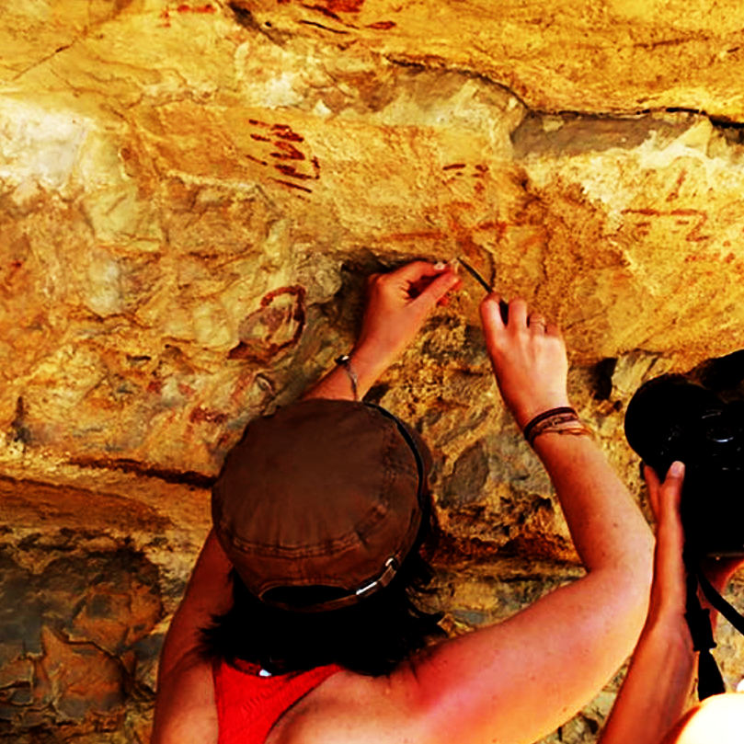

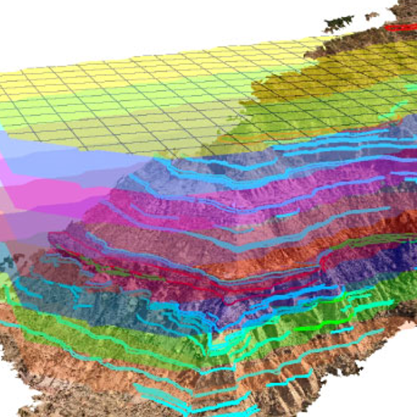




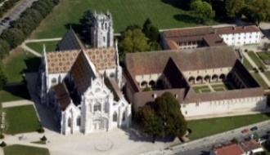


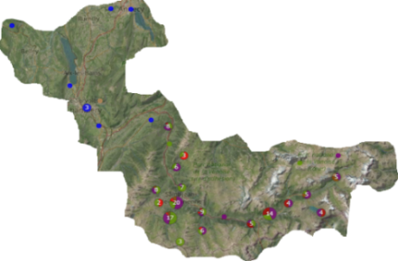
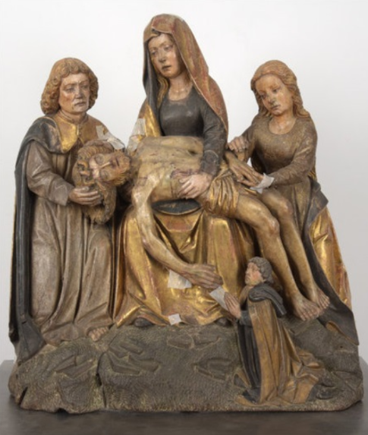
Patrimalp - the community:
1
Introduction
Context
Archeology
History of Arts
Geology
Social Sciences
Materials Sciences
Geography
Heritage Object
Chemistry
Computer Science
The development of interdisciplinary and integrated centered around a heritage object, studied in a cross-disciplinary aspect, within this multidisciplinary field.
Notes:
Patrimalp is a cross-disciplinary project involving multiple disciplines such as material sciences, archaeology, and geology represented by several laboratories and institutions.
1>>They aim for a cross-disciplinary study of heritage objects,
In which its is not a question of aligning the research results of each discipline, but defining a common understanding that synthesizes new knowledge across the different disciplines.
3>>And this necessitates the practice of interdisciplinarity with the help of computer science.
4>>So, the ambition is to develop an integrated and interdisciplinary approach centered around a cross-disciplinary entity within a multidisciplinary field.

Slide 4
Patrimalp - the objects
1
Introduction
Context
The heritage object is conceived as a boundary object: ^{[1,2]}
Acquires interpretative flexibility
Structures heterogeneous disciplines
Forms an intersection point facilitating cooperation
Recently used in France in the context of emergence heritage sciences ^{[3]}, and is at the core of Patrimalp.
Cross-disciplinary aspect: unique identity, robust interpretation
Examples:
parietal paintings on archaeological sites.
applied brocades on savoyard medieval sculptures.
S. L. STAR, J. GRIESEMER (1989) “Institutional ecology, ‘Translations’, and Boundary objects: amateurs and professionals on Berkeley’s museum of vertrebate zoologie”, Social Studies of Science, 19(3), p. 387-420.
P. TROMPETTE, D. VINCK (2009) « Retour sur la notion d’objet-frontière », Revue d’anthropologie des connaissances, vol. 3, n° 1, p. 5-27;
E. ANHEIM et al (2015) « Micro-imagerie de matériaux anciens complexes (I) », Revue de Synthèse,136(6), p. 329-354 : http://dx.doi.org/10.1007/s11873-014-0249-8
Notes:
(Reply to Cesar’s comments here about CH and patrimonial sciences)
As such, the heritage object is conceived as a "Boundary object“: a notion developed at the end of the 1980s by anthropologists of knowledge.
This notion articulates three properties: “Flexible interpretation”, “structuring heterogeneous groups”, and “being an intersection point of the multiple groups”
>>>Patrimalp is one of few scientific communities that is united over the same heritage object, conceived as being a boundary one having a cross-disciplinary traits.
>>>In the context of this project, two complex objects are recognized for study: parietal paintings found in archaeological sites & applied brocades found on Savoyard sculptures.
first, like any object, it is subject to different interpretations according to how we use it (interpretative flexibility): the chemist will not seek in the object the same thing that historian seeks for;
Second, it structures heterogeneous groups because it allows them to work together making it possible to organize a new community, while keeping significance to their original discipline;
And third it forms an intersection between the disciplines to facilitate their cooperation and knowledge sharing.

Slide 5
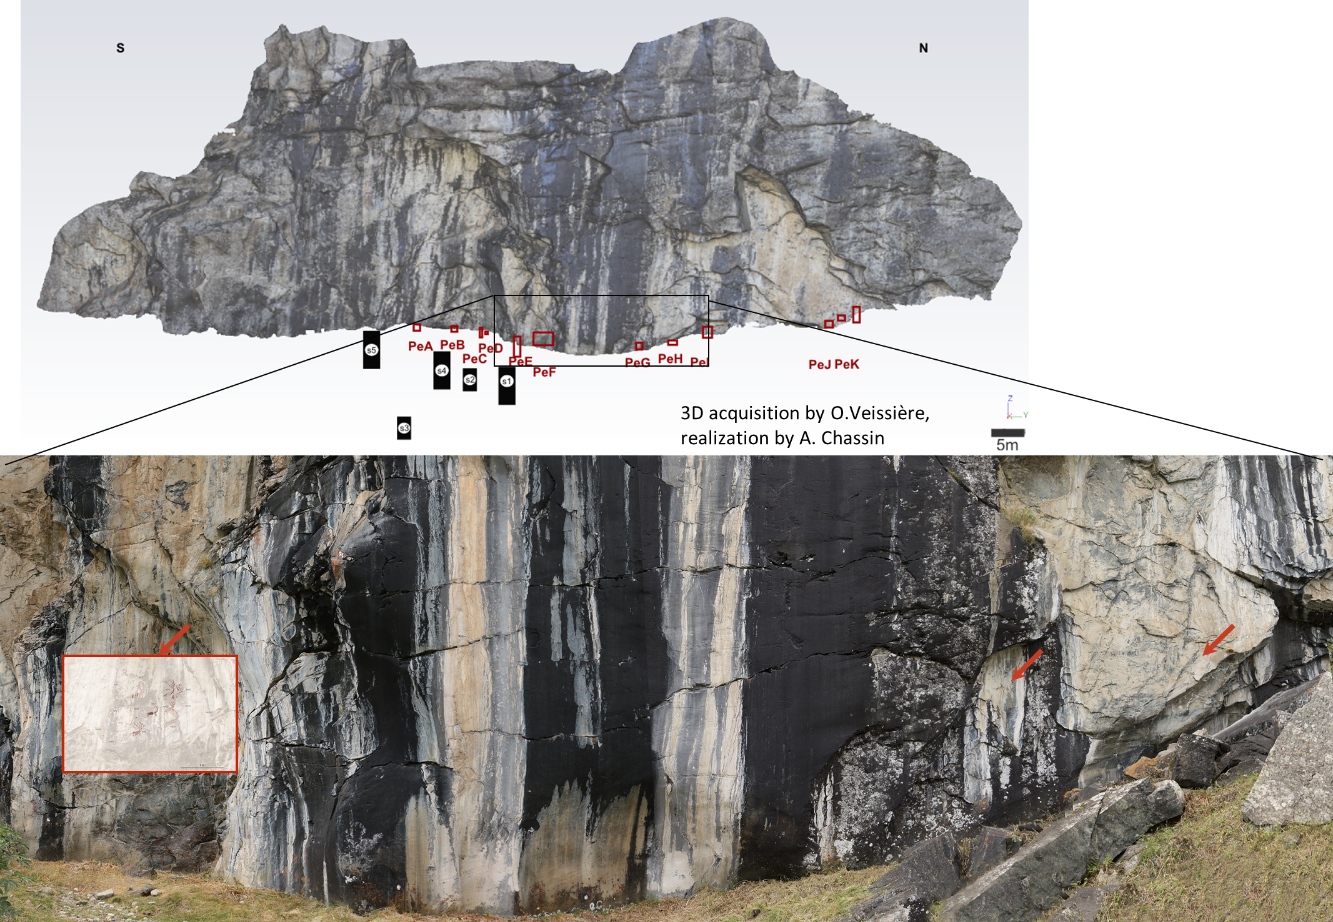
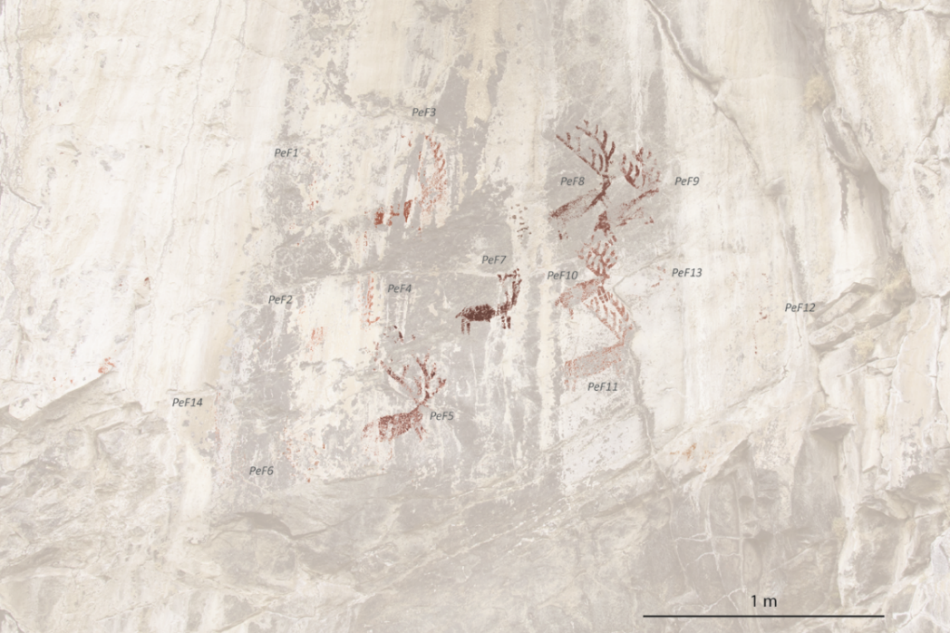
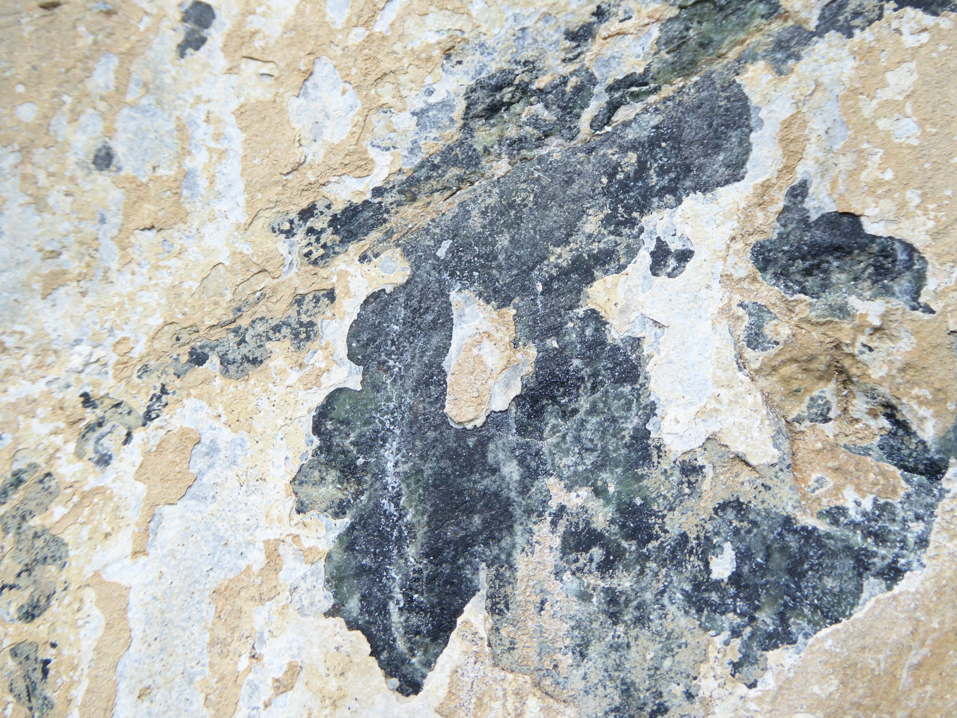
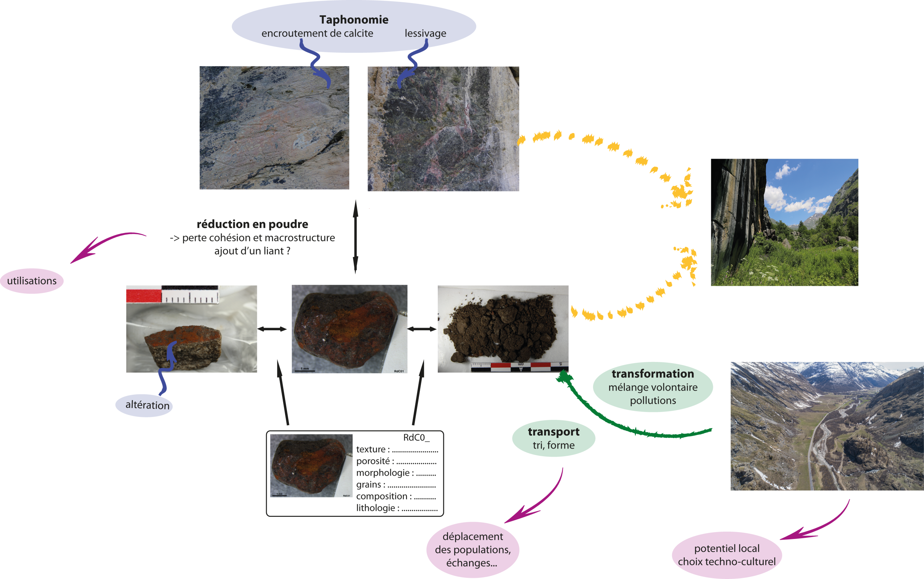
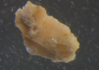
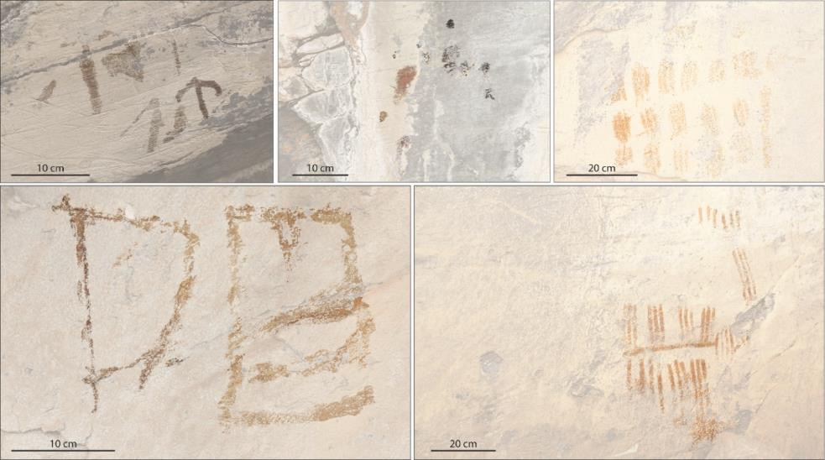
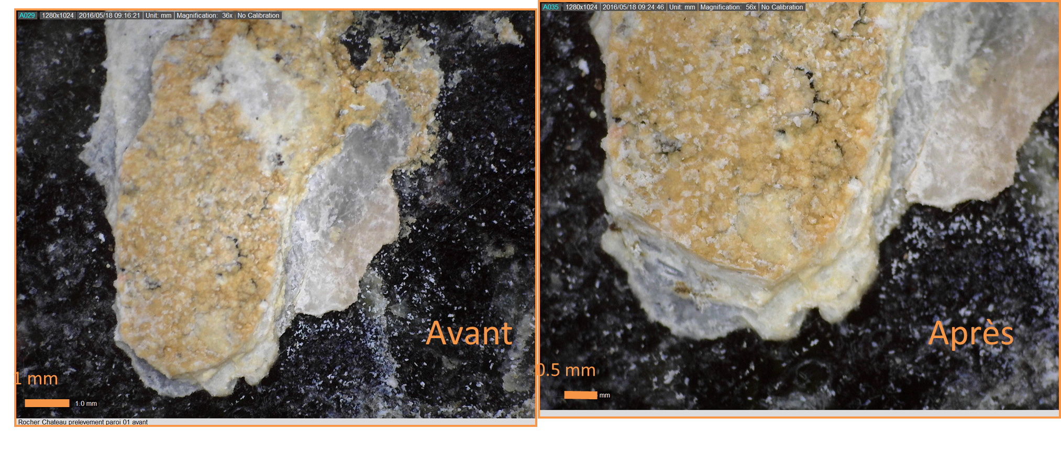
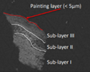
Patrimalp - the objects: Rock art sites
1
Introduction
Context
Le Rocher du Château
1750 m, Bessans, Haute Maurienne
A group of large red deer with oversized antlers painted in a concave area of the cliff forming a niche facing east.
Micro-sample from rock’s surface
Schematic figures composed of anchor-shape figures, grids, comb-shape figures…
SX
excavation square
Rock art panel
Notes:
Within rock art sites, a large corpus of paintings is spread in the western Alps attributed to the Neolithic period.
One of which is Rocher du Château site located in the valley of Bessans,
On each its two faces, the south and north, there are several rock art panels presenting paintings
>>> 1 such as a grp of red dears, or schematic figures of different shapes…
Zooming into these paintings, researchers take miscrosamples from each and study their composition, under specific procedures and analysis.
This study of their composition allows them to date these figures back to certain periods, and to link their findings with findings of other archaeological sites.

Slide 6
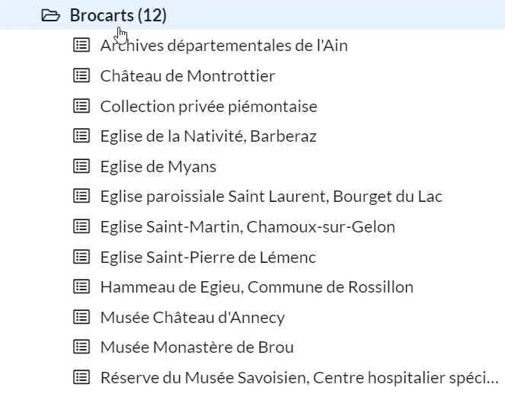
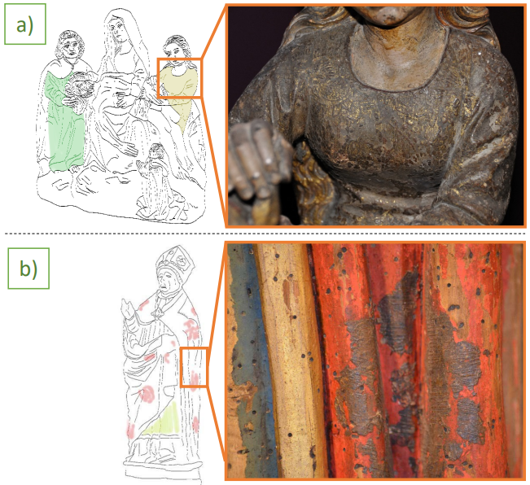
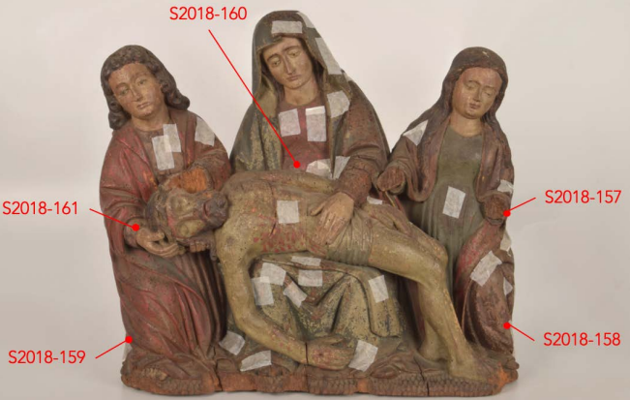
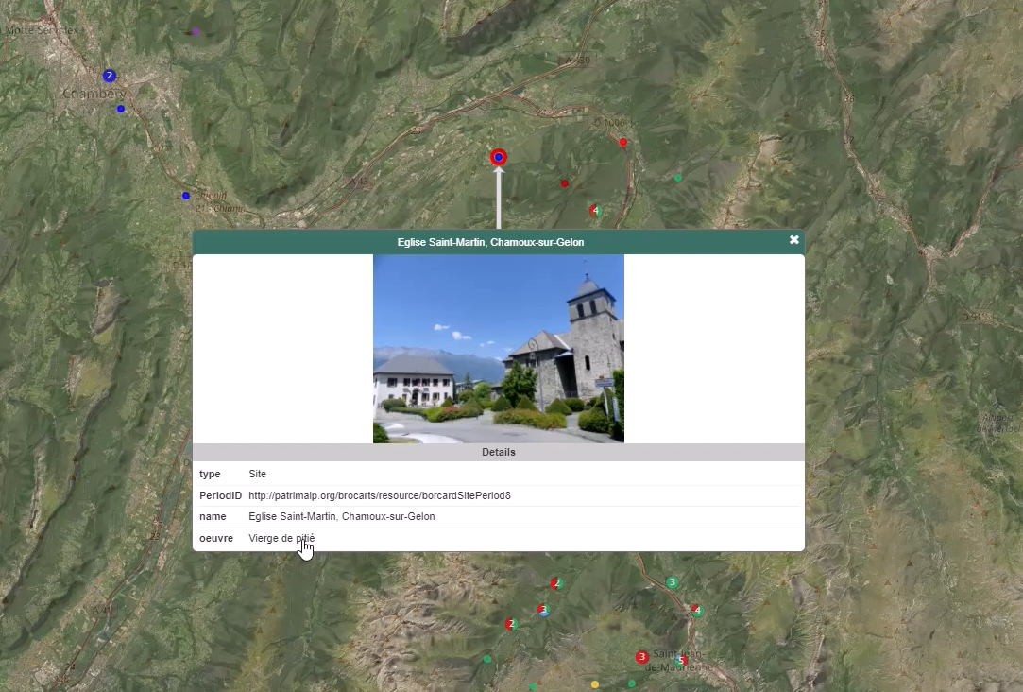
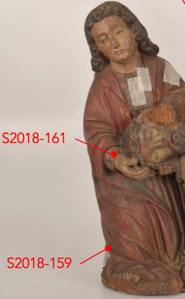
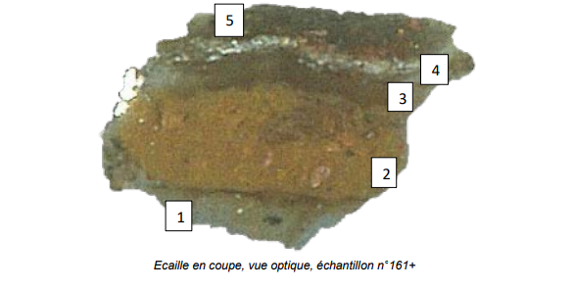
Patrimalp - the objects: Brocades
1
Introduction
Context
The « Vierge de Pitié » statue
It is a decorative technique on tin foil which imitates silk fabrics, and it has different patterns defined by shape and location.
« Saint Jean »
Notes:
The second example of heritage object is applied brocades which is a decorative technique on tin foil which imitates silk fabrics, and it has different patterns defined by shape and location.
>>>
In Patrimalp, a corpus of applied brocades studied which are found on Savoyard medieval sculptures.
>>>for example in the Saint-Martin cathedral, there is « Veirge de Pitié » statue on which several brocades are present such as on the Saint Jean.
Similar to RDC, researchers use a variety of analytical techniques to investigate the physical and chemical properties of the materials found in their composition.

Slide 7
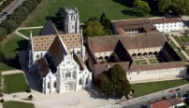


Patrimalp - the goal:
1
Introduction
Context
→ Heritage entities: Tangible entities vs. Intangible entities
→ Aspects of study: Intangible aspects, Spatiotemporal aspects, Materiality aspect, etc.
Enabling the formation and transmission of new knowledge about the materiality of a tangible entity that is a heritage object.
Understand the materiality of the tangible entity & link entities that have similar composition
Document the results & share knowledge across disciplines for re-use and reasoning
Transmit this knowledge for future generations for preservation & restoration purposes
Gain insights about the entity’s intangible aspects
Score
Think
Notes:
Taking the two previous examples as case-studies in Patrimalp, we realize that out of all heritage entities, there is an interest in tangible material ones.
…The importance of intangible immaterial entities such as Social practices, rituals and festive events, but they are out of the scope of Patrimalp
…And within tangible entities, out of the several aspects that could have been studied such as the value or evolution of these entities with time, there is a specific interest in studying the materiality of the entity which provides a consensus to study.
>>> Ans so, the study of this materiality and the formation of knowledge about it, is at the core of the interdisciplinary approach of Patrimalp.
- It allows not only to understand the composition, but also to link entities that have similar compositions
- To document the results and share the knowledge across the disciplines and build new knowledge
- To transmit this knowledge for future generations for preservation and restoration purposes
- And to gain insights on their intangible aspects such as dating the entities to certain periods of time and to specific populations that have occupied some sites.

Slide 8
Patrimalp - the challenge:
1
Introduction
Problematic
To find/build an ontology as a formal specification of a shared conceptualization centered on the « materiality of the entity » enabling « understanding and representation ».
Common understanding:
Common entity:
Shared goal:
“An ontology is a formal and explicit specification of a shared conceptualization” ^{[1,2,3]}
Ontology
Score
Think
materiality of the tangible entity
understanding & representation to form new knowledge
Formal logic e.g. FOL,
Conceptual modeling language e.g. UML, Semantic Web language e.g. OWL,
etc.
The abstract representation of knowledge (reality)
R. Gruber (1993) “A translation approach to portable ontology specifications.” Knowledge acquisition, vol. 5, no. 2, pages 199–220, 1993;
N. Guarino, P. Giaretta (1995) “Ontologies and knowledge bases”, Towards very large knowledge bases, pages 1–2, 1995;
N. Guarino et al. (2009) “What is an ontology?” Handbook on ontologies, pages 1–17, 2009.
Notes:
To build this interdisciplinary approach,
It is necessary to define common understanding, centered around a common entity which is the materiality of heritage objects,
and a shared goal: which is their understanding and representation.
And indeed it is with ontologies that we can achieve such a a common understanding.
Because an ontology provides a formal and explicit representation of a shared conceptualization, whether this formal representation is offered in a formal language or conceptual modeling language or a semantic web language.
And so the challenge is to find or build an ontology as a formal representation of a shared conceptualization centered on understanding and representing the materiality of tangible entities.
((((As a result, this allows overcoming the syntactic and semantic heterogeneity across multiple discipline, and to achieve interoperability, resulting in proper communication, while building and sharing knowledge. )))))
(((((A conceptualization refers to the abstract representations of knowledge, which can be used to reason, make decisions, or solve problems))))

Slide 9


Patrimalp - the requirements:
1
Introduction
Problematic
Only an ontology of composition relations can represent the materiality of a tangible entity.
An entity and its parts
An entity its similar entities under specific criteria
An entity and its location
An entity and its constitution elements
The ontology should be domain-independent in order to achieve interdisciplinary integration.
The modeling scope of this ontology?
The modeling scope of this ontology?
X
X
X
X
Y
X
Y
Y
Y
Y
The abstraction level of this ontology?
The abstraction level of this ontology?
Geological data
Archeological data
Materials data
Colors data
History of Arts data
Social sciences data
Geographical data
Notes:
For this ontology, we pose two main questions:
What shall be the scope of this ontology to allow for modeling and understanding the materiality?
What shall be the abstraction level of this ontology to allow for an interdisciplinary future integration?
To answer the first question, we believe that only a model of composition relations can represent the material composition of entities. It will allow to capture the relations between:
1- an entity and its parts, such as the micro-sample taken from a rock art figure, and the hematite powder producing the color of the red coloring matter
2- an entity as collective and the entities it groups under certain semantics e.g. a collection of figures sharing a common shape, collection of statues having the same brocade design and/or composition
3- an entity and its location, whether its is the spatial region that locates it e.g. the Rocher-du-chateaux site situated in the Bessans valley,
or the entity on which it is located e.g. the schematic figures located on the rock art panel, or the brocade located on the robe of the statue.
4- and an entity and its constituents e.g. the type of clay constituting the "Saint Jean" statue
-------------------------------------------------
As for the second question related to the ontology’s abstraction level,
We belive that the ontology should not be domain-dependent, rather be domain independent in order to achieve an interdisciplinary integration of knowledge across multiple domains.

Slide 10
Research Proposal:
1
Introduction
Problematic
Objects
Study:
Challenge
Ontology:
Materiality of tangible entities
A formal representation of a shared conceptualization
Patrimalp
Goal
Requirements
Shared goal:
Scope & abstraction
Enable the formation and transmission of new knowledge
Composition relations
Domain independent ontology
I
Modeling the composition of a tangible entity as a complex structure to understand and represent its materiality, using composition relations.
Literature review on ontologies in the CH field that can respond to this modeling problem.
Notes:
Now that we have identified
0- The common interest in Patrimalp to be the materiality of tangible entities
1- and the shared goal to be the formation and transmission of new knowledge around this materiality
2- and the challenge to be finding or building an ontology
3- whose scope is composition relations and whose abstraction level is not domain-dependent
4- we identify the first motivation of our work to be: Modeling the composition of a tangible entity as a complex structure (i.e. an object, a place, a collection) in a manner that enables the understanding and formation of knowledge about its materiality, using semantically rich ontological relations
And to address it, we need to investigate the existing generic ontologies in the CH field to check whether an existing ontology can answer such a modeling problem
It is important also to mention that there is second state of the art section which follows the first

Slide 11
Table of contents
1
4
2
3
Introduction
Conclusion &
Perspectives
State of the art
Contributions
I: Ontologies for Cultural Heritage
II: Foundational Ontological Relations
Notes:
For that, I introduce first the Patrimalp project in the introduction section,
then a two-parts SOA,
followed by the contributions section,
after which I conclude.

Slide 12
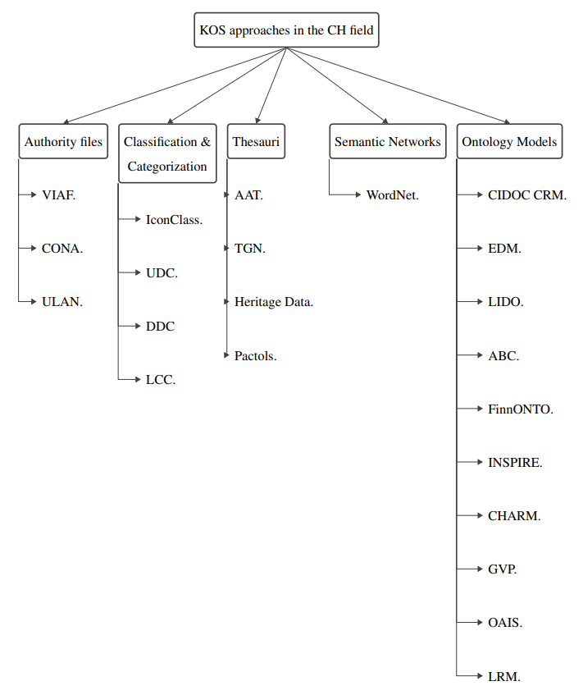
Managing & Organizing CH data:
2
State-of-Art
Ontologies for Cultural Heritage
knowledge Organization Systems for CH
Managing Cultural Heritage (CH) data:
Memory institutions, Organizational institutions and infrastructures, Information systems
Organizing CH data: knowledge Organization Systems
Authority files, Classification and categorization systems, Thesauri, Semantic Networks, Ontology models
Classification Criteria for ontology models:
Geographical scale: National, International
Semantics and formality level: Metadata-based, Thesauri-based, Formal ontologies
Modeling scope: Data-centric, Spatial-centric, Entity-centric
Notes:
For that, we first distinguished between institutions whose goal is to manage CH data i.e. to collect data from different sources such as memory institutions
and other knowledge organization systems which organize and models CH data using different structures including authority files, classification systems, thesauri, and ontology models.
1>>> focusing on KOS, we classified some systems in the CH field according to their structure in which they are presented in the literature.
2>>> out of which, we focus primarily on ontology structures.
Which we systematically classified based on specific criteria. This criteria includes:
The geographical scale of the ontology which considers the spatial boundaries or scopes from which CH entities are taken. This criterion emphasizes the extent to which the models are designed to capture CH information at different geographical scales, ranging from national and international contexts.
The semantics and formality level of the model which considers semantic representation used to capture CH entities, relationships, and concepts, as well as the level of formalization and expressivity, including metadata-based models, thesauri based models, and formal ontologies or conceptual models.
And the last criterion is the modeling scope which refers to the subject matter of the model, in which we identified three: data-centric models, spatial-centric models, and entity-centric models.

Slide 13
Modeling CH entities using Ontologies:
2
State-of-Art
Ontologies for Cultural Heritage
A criteria-based selection of relevant approaches:
Geographical Scale | Ontology Model
National | FinnONTO
International | CIDOC CRM, Europeana, LIDO, ABC,Inspire, CHARM, GVP, OAIS, LRM
Geographical Scale | Ontology Model
National | FinnONTO
International | CIDOC CRM, Europeana, LIDO, ABC,Inspire, CHARM, GVP, OAIS, LRM
Semantics & Formality level | Ontology Model
Metadata-based models | EDM, LIDO, ABC
Thesauri-based models | FinnONTO, GVP
Formal Ontologies/CDM | CIDOC CRM, CHARM, Inspire, EDM, OAIS, LRM
Semantics & Formality level | Ontology Model
Metadata-based models | EDM, LIDO, ABC
Thesauri-based models | FinnONTO, GVP
Formal Ontologies/CDM | CIDOC CRM, CHARM, Inspire, EDM, OAIS, LRM
CIDOC CRM
EDM
CHARM
Modeling scope | Ontology Model
Data-centric | LIDO, ABC, LRM, OAIS
Spatial-centric | Inspire, CRMarchaeo
Entity-centric | CIDOC CRM, EDM, FinnONTO, CHARM
Modeling scope | Ontology Model
Data-centric | LIDO, ABC, LRM, OAIS
Spatial-centric | Inspire, CRMarchaeo
Entity-centric | CIDOC CRM, EDM, FinnONTO, CHARM
Investigate their composition relations (structural & spatial)
Notes:
After classifying the ontology models into each of the three criterion, we selected one value of each:
For the geographical scale, we believe that international scale models which have a broader scope, enable the consideration of diverse entity types fostering a cross-cultural research, thus excluding the FinnOntology which is at the Finnish national scale.
For the semantics and formality level, we selected formal ontologies and conceptual models which model a shared conceptualization rather than models derived from existing thesauri which use vocabularies from a specific thesauri, or those based on metadata which capture information about the identification and description CH entities for retrieval and management purposes.
And for the modeling scope, we selected those that model entities themselves, rather than their bibliographic records or their sole geographical properties.
The selection based on these three critaria resulted in three main models which we need to review their capabilities in modeling the composition of entities. And for that we will study the composition relations in them, the structural and spatial ones, that allow for achieving the intended representation of the materiality.

Slide 14
Modeling CH entities using Ontologies:
2
State-of-Art
Ontologies for Cultural Heritage
An analysis of the relevant models: CIDOC Conceptual Reference Model (CRM) V7.1.2
“An 'ontology' for CH information i.e. it describes in a formal language the explicit and implicit concepts and relations relevant to the documentation of CH”. (https://cidoc-crm.org/node/202)
Structural relations:
P45 consists of
P46 composed of
Spatial relations:
P53 has former or current location
P54 has current permanent location
P55 has current location (currently holds)
P59 has section (is located on or within)
P89 falls within (contains)
Composition Relations
CIDOC CRM could be used as a complementary model for representing the spatiotemporal aspects of a CH entity.
Notes:
The CIDOC CRM represents an 'ontology' for cultural heritage information i.e. it describes in a formal language the explicit and implicit concepts and relations relevant to the documentation of cultural heritage.
The latest Official version of CIDOC CRM is the 7.1.2 version (Base for initial ISO submission) based on FOL. It is available in RDFS and encodes relations using the prefix P followed by a number and the name of the property.
1>>>
For composition relations, it includes the following allowing for a number of structual and spatial representations of entities such as consists of and composed of.
2>>>
Although these do not cover the desired composition relations for representing the overall materiality of an entity,
CIDOC CRM does extensively provide classes and relations for representing the spatiotemporal aspects of CH entities. And thus could be employed as a complementary model to cover this purpose.

Slide 15
Modeling CH entities using Ontologies:
2
State-of-Art
Ontologies for Cultural Heritage
An analysis of the relevant models: The Europeana Data Model (EDM)
“Its goal is to collect metadata about CH entities from European CH institutions, and to enable the search and discovery of these items. It is aimed at being an integration medium for collecting, connecting and enriching the descriptions provided by Europeana’s content providers”. (Europeana Data Model | Europeana PRO)
Structural relations:
ore: aggregates – from the OAI Object Reuse and Exchange (ORE) namespace
dcterms: has Part – from the Dublin Core namespaces
Spatial relations:
edm: current Location
dcterms: spatial
Composition Relations
EDM could be used as a complementary data model for describing other representations as descriptive properties for the object.
Notes:
EDM is the data model developed by the Europeana project whose goal is to collect metadata about CH entities from European CH institutions, and to enable the search and discovery of these items through a unified representation named the Europeana data model.
It is avaialble in RDF format and consist of classes and properties to represent meta-data about CH documents.
EDM re-uses some classes and properties from existing namespaces such as DC terms.
For example, in our search for structural relations in it, we find two: one shich is re-used from the ORE model (ore:aggregates) and the other from DC terms (dcterms:hasPart)
And for spatial relations: it defines the edm « current location » property
>>> As such, it does cover really composition relations.
This is because its modeling scope is metadata oriented. It focuses on being an integration medium for collecting, connecting descriptions about CH entities provided from different institutions.
So, it could be used as a complementary models for purposes including descriptive elements such as bibliographic and library records about the CH entity.

Slide 16
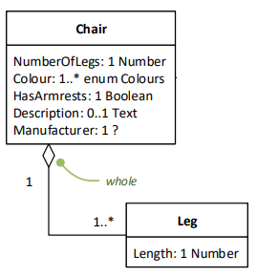
Modeling CH entities using Ontologies:
2
State-of-Art
Ontologies for Cultural Heritage
An analysis of the relevant models: The Cultural Heritage Abstract Reference Model (CHARM)
“It is an abstract reference model intended to be used by a wide and diverse range of organizations and individuals in order to achieve a common understanding about anything that may be the recipient of cultural value”. (Overview of CHARM (charminfo.org))
Aggregation relationships:
SubPlace (a Place and itself)
SubDivision (a LandDivision and itself)
Support (a MaterialEntity and a MaterialAspect)
Content (a StructureEntity and a MaterialEntity)
Fragment (a CompleteStructure and a StructureFragment, etc.)
Substructure (a CompleteStructure and itself)
SubOject (a CompleteObject and itself)
Element (a ConstructedStructure and a ConstructiveElement)
Composition Relations
CHARM could be used as a user-friendly complementary model to construct domain-specific CH ontologies enabling its employment by domain institutions.
Notes:
CHARM is an abstract reference model intended to be used by a wide and diverse range of organizations and individuals in order to achieve a common understanding about any thing that may be the recipient of cultural value.
The model is expressed in ConML; a conceptual modeling language developed for humanities and social sciences, similar to UML rather than to ontology standards.
when it comes to relationships, out of the multiple possible representations like subsumption and classification, ConML uses aggergation relationships as a type of an association relationship as semantic links connecting classes.
Aggregation relationships express the semantics of a part-whole relation such as a chair and its legs.
>>>CHARM specializes multiple relations such as SubPlace , SubDivision, Fragment, and so on holding between specific categories.
>>>To use CHARM, it is advised to extend it into a particular model according to user’s needs through well-defined extension mechanisms. Which makes it possible to be used as user-friendly complementary model to construct domain-specific models within the CH field.

Slide 17

Synthesis:
2
State-of-Art
Ontologies for Cultural Heritage
I
Modeling the composition of a tangible entity as a complex structure to understand and represent its materiality, using composition relations.
Literature review on ontologies in the CH field that can respond to this modeling problem.
 | CIDOC CRM | EDM | CHARM
Pros | Spatiotemporal elements | Descriptive elements | Domain-specific elements
Cons | Composition (structural and spatial) relations
Notes:
Going back to the identified motivation behind this literature review which is modeling the composition of a tangible entity using composition relations
We could not find a model that provides a semantically rich set of relations (whether structural or spatial or both).
These are not shortcomings of each models, it is rather the fact that model has its own modeling scope where for example CIDOC CRM offers competent elments t model the spatiotemporal aspects of an entity, EDM for descriptive elements, and CHARM for more domain-specific and user-friendly purposes.
Thus, We recognize the need for a semantically robust and well-formalized set of foundational relations that can capture the composition of a CH entity and enable an accurate representation of its materiality.

Slide 18
Synthesis:
2
State-of-Art
Ontologies for Cultural Heritage
I
Modeling the composition of a tangible entity as a complex structure to understand and represent its materiality, using composition relations.
Literature review on ontologies in the CH field that can respond to this modeling problem.
 | CIDOC CRM | EDM | CHARM
Pros | Spatiotemporal elements | Descriptive elements | Domain-specific elements
Cons | Composition (structural and spatial) relations
II
Acquiring a number of foundational ontological, structural and spatial, relations that enable representing the composition of a tangible entity, within a theory.
Literature review on studies on foundational relations to find a taxonomy/theory.

Slide 19
Table of contents
1
4
2
3
Introduction
Conclusion &
Perspectives
State of the art
Contributions
I: Ontologies for Cultural Heritage
II: Foundational Ontological Relations
Notes:
For that, I introduce first the Patrimalp project in the introduction section,
then a two-parts SOA,
followed by the contributions section,
after which I conclude.

Slide 20
Overview:
2
State-of-Art
Foundational Ontological Relations
META (Foundational - Top-level – Upper) Ontologies
Mid-level Ontologies
Core ontologies
Domain/Task Ontologies
Application Ontologies
What?
Formal and (often) primitive relations that play a fundamental role in ontologies.
Less specific
More generic
Where?
Applied Ontology field:
Entities & entities
Entities & properties
More specific
Less generic
How?
Taxonomies
Theoretical Frameworks
Notes:
Foundational ontological relations are formal and (often) primitive relations that pay a fundamental role in the foundations of ontological analysis and modeling.
>>>1
Although the study of formal relations hold a central position in classical philosophical literature, their formalization in computer science, has been explored in the applied ontology literature as investigating fundamental relationships between entities or entities and properties, at a meta-level. According the figure showing the abstraction levels of ontologies from more specific to less specific, the meta-level provides ontological theories that formalize meta-conceptualization using a meta-modeling langues i.e. independent of any domain, application, or field.
>>>2
At this level, foundational relations are studied in the form of taxonomies of relations which generalize and specialize relation types, or in theoretical frameworks as formal theories.

Slide 21
Categorization:
2
State-of-Art
Foundational Ontological Relations
Spatial Relations
Structural Relations
Formal Applied Ontological studies
Cognitive Sciences
Combining both Meronomy & Mereology
Spatial Location
Spatial Connection
Formal Parthood
Part-Whole Taxonomies
Conceptual Modeling Lang
Knowledge Representation Lang
Location
Topology
Mereology
Meronomy
UML
ER/
ORM
DL
FOL
Mereology
Varzi, 1996
Casati, 1999
Varzi, 2007
Randell, 1992
Randell, 1989
Cui, 1993
Simons, 1987
Varzi, 2003
Iris, 1986
Winston 1987
Gerstl & Pribbenow 1995 - 1996
Odell
Opdahl
Barbier
Shanks
Berardi
Pitrick.M.
Keet, 2006
Schulz
Sattler
Artale
Guizzardi, 2005
Keet, 2008
Mereotopology
Bittner, 2005
Varzi, 1993 – 1996 - 2007
Casati, 1999
Legend:
Properties of part-whole relations
Relation
Field of study
Approach
Notes:
To investigate these relations, we categorized some popular extant approaches pertaining to both structural and spatial relations based on their context of studies:
>>>1-2
Under the spatial relations we have
Location for spatial relation studied in formal applied ontology by Varzi, Casati and some others
And Topology for spatial connection
>>>3
Under structural relations we have
Mereology as the formal theory of parthood by Simons
>>>4
The combination of mereology and topology as mereotopology
>>>5 on the other hand structural relations have been also studied within cognitive sciences as meronomy yielding in several taxonomies of part-whole relations in the filed of linguistics and natural language.
>>>6 Other efforts have aimed at combining mereology and meronomy in formal frameworks using
>>>7 either conceptual modeling languages such as UML, ER, and ORM
>>>8 or knowledge RR such as DL and FOL
>>>9 additional studies have studied properties of relations such as functionality and dependence.
Now for time constraints I will not go into the details of each, they are explained in the manuscript in details
>>>10 But I will give an overview of two studies, starting with mereology.

Slide 22
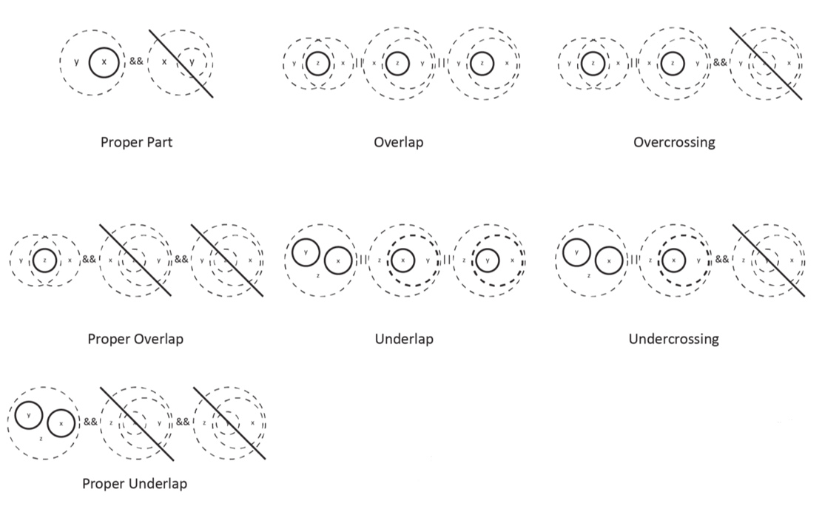
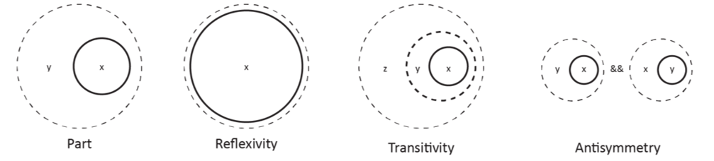
Categorization:
2
State-of-Art
Foundational Ontological Relations
(Pa1) | Reflexive | P(x,x)
(Pa2) | Transitive | P(x,y) ∧ P(y,z) → P(x,z)
(Pa3) | Antisymmetric | P(x,y) ∧ P(y,x) → x = y
Mereology : Formal theories of Parts P(x,y)
Composition Principles
(D1) | Proper-part | PP(x,y) =_{df} P(x,y) ∧ ¬P(y,x)
(D2) | Overlap | O(x,y) =_{df} ∃z( P(z,x) ∧ P(z,y) )
(D3) | Underlap | U(x,y) =_{df} ∃z( P(x, z) ∧ P(y, z) )
(D4) | Overcross | OC(x,y) =_{df} O(x, y) ∧ ¬P(x, y)
(D5) | Undercross | UC(x,y) =_{df} U(x, y) ∧ ¬P(y, x)
(D6) | Proper-overlap | PO(x,y) =_{df} OC(x, y) ∧ OC(y, x)
(D7) | Proper-underlap | PU(x,y) =_{df} UC(x, y) ∧ UC(y, x)
General Extensional Mereology
(GEM)
+ (Pa5)
General Mereology
(GM)
+ (Pa8)
Extensional Closure Mereology
(CEM)
+ (Pa8)
+ (Pa5)
Closure Mereology
(CM)
+ (Pa6, Pa7)
+ (Pa6, Pa7)
Extensional Mereology
(EM)
+ (Pa5)
(Pa4) | PP(x, y) → ∃z( P(z, y) ∧ ¬O(z, x) )
(Pa5) | ¬P(y, x) → ∃z( P(z, y) ∧ ¬O(z, x) )
(Pa6) | U(x, y) → ∃z ∀w ( O(w, x) ↔ ( O(w, x) ∨ O(w, y) ) )
(Pa7) | O(x, y) → ∃z ∀w ( P(w, z) ↔ ( P(w, x) ∧ P(w, y) ) )
(Pa8) | ∃xφ → ∃z∀y(O(y, z) ↔ ∃x(φ ∧ O(y, x) ) )
Decomposition Principles
+ (Pa6, Pa7)
A visual representation of some mereological predicates.
Source : Figure from "The ultimate parts" blog article.
Minimal Mereology
(MM)
+ (Pa4)
Ground Mereology
(M)
(Pa1, Pa2, Pa3)
Notes:
Mereology if formal study of the parthood relation holding between a whole and part
Ground Mereology (M) is the basic theory having “part-of” – P(x,y) – as a primitive relation:
M is the common dominator of the parthood relation, with part-of as a primitive relation (i.e. It does not have a definition) capturing a partial order that is always reflexive, antisymmetric and transitive.
using these three basic axioms of part-of, several other merological predicates can be built.
Strating from ground mereology, adding axioms to the theory yields in extension.
* weak supplementation axiom (a4) , results in Minimal mereology (MM)
* strong supplementation axiom (a5), results in extensional mereology (EM)
* Finitary operation: finitary sum (a6) and finitary product (a7), results in closure Mereology (CM)
* Unrestricted fusions (a8), results in General Mereology (GM)

Slide 23
Synthesis:
2
State-of-Art
Foundational Ontological Relations
Although studies on Mereology have provided a rigid formal framework for representing and assessing parthood relations, however, mereology have been shown
too weak to capture the distinctions that mark different types of ((part-whole)) relations
too strong to hold as a generalization of a theory of part-whole relations at a conceptual level
Although studies on Meronomy have allowed for common-sense reasoning over part-whole relations in real life examples, they have been carried out in non-formal frameworks.
Other efforts that have integrated the strengths of both (Meronomy & Mereology):
Guizzardi, 2005: Proposes an extension of mereology with a theory of Integral wholes
Distinguishes four types of relations based on « ontological entities », then types of relations based meta-properties e.g. shareabiliy and separability (using ontological dependence)
its primary objective was to support conceptual modeling tasks, particularly within the context of UML
This contribution evolved later to be the current UFO foundational ontology which we inspect later in
Keet and Artale, 2008: Develops a taxonomy of meronymic and mereological part-whole relations
Relies heavily on the axiomatization of DOLCE’s categories, & considers relations as part-whole typologies
Spatial properties of entities
Notes:
After investigating a wide number of studies within multiple aspects, we concluded the following:
Although studies on Mereology have provided a rigid formal framework for representing and assessing parthood relations, however, mereology have been shown
too weak to capture the distinctions that mark different types of ((part-whole)) relations
too strong to hold as a generalization of a theory of part-whole relations at a conceptual level
>>>1
Although studies on Meronomy have allowed for common-sense reasoning over part-whole relations in real life examples, they have been carried out in non-formal frameworks.
>>>2
Other efforts that have integrated the strengths of both (Meronomy & Mereology): out of which we recognize two significant ones:
Guizzardi, 2005: Proposes an extension of mereology with a theory of Integral wholes
Distinguishes four types of relations based on « ontological entities », then types of relations based meta-properties e.g. shareabiliy and separability (using ontological dependence)
its primary objective was to support conceptual modeling tasks, particularly within the context of UML
This contribution evolved later to be the current UFO foundational ontology which we inspect later in
Keet and Artale, 2008: Develops a taxonomy of meronymic and mereological part-whole relations
Relies heavily on the axiomatization of DOLCE’s categories, & considers relations as part-whole typologies

Slide 24
Synthesis:
2
State-of-Art
Ontologies for Cultural Heritage
II
Acquiring a number of foundational ontological, structural and spatial, relations that enable representing the composition of a tangible entity, within a theory.
Literature review on studies on foundational relations to find a taxonomy/theory.
 | Mereology | Meronomy | Location
Pros | Formality of relations | Common-sense reasoning on relations | Spatial properties
Cons | Unified theory of relations
Notes:
Going back to the identified motivation behind this literature review which is Acquiring a number of foundational ontological relations that enable representing the composition of a tangible entity, within a theory.
We could not find a unified theory of relations which can group together a minimal set of relations that are necessary to model the composition
Whci can be as formal as a mereological theory
And as cognitively studied as meronomy
And accounts for spatial aspects.
>>>1
We recognize the need for a unified theory that encompasses a set of foundational ontological relations, facilitating the structural and spatial representation of entities to describe their composition

Slide 25
2
State-of-Art
Synthesis
I
Modeling the composition of a tangible entity as a complex structure to understand and represent its materiality, using composition relations.
Literature review on ontologies in the CH field that can respond to this modeling problem.
 | CIDOC CRM | EDM | CHARM
Pros | Spatiotemporal elements | Descriptive elements | Domain-specific elements
Cons | Composition (structural and spatial) relations
II
Acquiring a number of foundational ontological, structural and spatial, relations that enable representing the composition of a tangible entity, within a theory.
Literature review on studies on foundational relations to find a taxonomy/theory.
 | Mereology | Meronomy | Location
Pros | Formality of relations | Common-sense reasoning on relations | Spatial properties
Cons | Unified theory of relations
Notes:
And based on the two needs concluded from both parts of the state of the art, we aim in this thesis to provide a unified theory of composition structural and spatial relations, within the context of an ontology.

Slide 26
Table of contents
1
4
2
3
Introduction
Conclusion &
Perspectives
State of the art
Contributions
I: Ontologies for Cultural Heritage
II: Foundational Ontological Relations
Notes:
For that, I introduce first the Patrimalp project in the introduction section,
then a two-parts SOA,
followed by the contributions section,
after which I conclude.

Slide 27
Fundamental Objective:
3
Contributions
Approach
Objects
Common entity:
Challenge
Ontology:
Materiality of tangible entities
A formal representation of a shared conceptualization
I
Patrimalp
Goal
Requirements
Shared goal:
Scope & abstraction
Enable the formation of new knowledge
Composition relations
Domain independent ontology
II
Fundamental Objective of the thesis:
Ontology: Representing and modeling the composition of a tangible entity in general, and a Cultural Heritage tangible entity in particular, using foundational ontological structural and spatial relations, within a Applied Ontology approach [F. Danash et al., 2020].
F. Danash, D. Ziebelin, E. Chalmin, A Parthood Approach for Modeling Tangible Objects’ Composition TOC – An application on Cultural Heritage. In Book: The 17th Extended Semantic Web Conference, ESWC2020. Lecture Notes in Computer Science, vol 12124. Conference short paper.
Notes:
Starting with identifying the objective:
This is to represent and model the composition of a tangible entity in general, and a Cultural Heritage tangible entity in particular, using foundational ontological structural and spatial relations, within a Applied Ontology approach.
The preliminary study of this proposal has been accepted as a short paper in 2019 and published in 2020.

Slide 28
Proposal: FORT
3
Contributions
Approach
META (Foundational - Top-level – Upper) Ontologies
Mid-level Ontologies
Core ontologies
Domain/Task Ontologies
Application Ontologies
FORT : Foundational Ontological Relations Theory
meta-ontology in terms of both, the conceptualization which it specifies and the modeling language which it uses
modular ontology i.e. consists of relations modules, each addressing a specific relation:
Parthood (& Dependence)
Membership
Location
Entity location
Constitution
relations-exclusive ontology i.e. independent of ontological categories
X
X
X
X
Y
X
Y
Y
Y
Y
Notes:
To address this objective we propose an ontological theory of Foundational Ontological Relations, named FORT.
For building FORT, we specify some requirements:
>>>1
First, the positioning of FORT as an ontology in the pyramid of ontology abstraction levels holds at the meta-level in terms of (1) the meta-conceptualization that it specifies and (2) the meta-modeling language used,
And this identifies our proposal as a contribution to the Applied Ontological field in which meta-ontologies are proposed.
>>>2
Second, as FORT will be addressing foundational relations of different types and axiomatizations, it consists thus of multiple relation modules as micro-theories each addressing a specific relation in order to achieve the representations identified in the introduction. These are:
>>>3 The parthood relation for representing the link between an entity and its different parts
>>>4 The membership relation for representing the link between an entity as collective and the entities it groups under certain semantics
>>>5 The constitution relation for representing the link between an entity and its constituents
>>>6 The location relation for representing the link between an entity and the spatial region that locates it
>>>7 and The entity-location relation for representing the spatial constraints among entities
>>>8
And as a last characteristic of FORT, it is an ontology of exclusive relations and rules i.e. it is free of entity types and does not define any ontological categories as constraints on the domain and range of the relations.
This does not neglect the importance of having categories and the need for them to achieve a comprehensive representation of an entity. However,
A- we are at a meta-level, this means that if we are to define categories, these would also be ones at the meta-level i.e. very top level conceptualization of reality such as saying Object, in general or spatial region in general.
>>>> and this first is not of benefit for the CH application in particular, for that it will not help to identify all heritage object as « object »
>>> and second, this becomes another type of problematic that could needs much more than a thesis’s lifetime. It becomes a problem of building a foundational ontology which is a very complex subject matter.
B- as identified in the objective, the goal in this thesis i firstly to allow for representing the materiality i.e. providing the means for this representations, a problem which we investigated the literature according to it + and decided to approach using foundational ontological relations. And based on that, our primarily focus should be on providing these means, and later we can think of what possible ontologies could be re-used or built to a represent the entity itself.

Slide 29
Methodology:
3
Contributions
Approach
Modelisation Phase: Formalization of the FORT ontology
Addressing different specification choices: Expressivity & Decidability
Formalizing each at multiple levels: Theoretical & Empirical
Bridging the two specifications
Theoretical formalization
Empirical validation
Reference Ontology
FOL
CL
FORT ontology
Lightweight Ontology
SROIQ
OWL
Notes:
To build FORT, we construct and adhere to a ontology engineering methodology, which:
>>>1 Addresses different specification choices: Expressivity & Decidability
The original specification is the “reference-ontology” addressing expressivity using a highly-expressive formal language (FOL), and the secondary specification is the lightweight-ontology addressing decidability using a decidable formal language (SROIQ).
This way of promoting for a two-fold specifications of an ontology is a way of compromising the trade-off between expressivity and decidability.
>>>2 Formalizes each at multiple levels: Theoretical & Empirical
This is by providing for each specification, a theoretical formalization e.g. FOL, SROIQ, and secondly an empirical serialization that allows for validation e.g. CLIF, and supports its use in practice e.g. OWL
>>>3 and Bridges the two specifications
by building a translation procedure which allows computing a lightweight secondary formalization from the reference original formalization
This is the modelisation phase of the methodology

Slide 30

Methodology:
3
Contributions
Approach
Employment Phase: Use of the FORT ontology for an interdisciplinary integration
META (Foundational - Top-level – Upper) Ontologies
Mid-level Ontologies
Core ontologies
Domain/Task Ontologies
Application Ontologies
Global Ontology
Layer
FORT ontology
FORT ontology
Core/ mid-level Ontology
Layer
Domain Ontology
Layer
A
B
Notes:
Now to use FORT as a meta-ontology in practice, we will design possible employment methods to show where can FORT be positioned within an architecture of ontologies
Examples of core mid/level layer: CIDOC
Examples of domain application task: archaeology ontology

Slide 31
The FORT reference ontology (FOL)
3
Contributions
Modelisation
Methodology step 1:
Specify (conceptually) and formalize (logically) the relations of FORT in a highly-expressive formal language that is adequate for the formalization of foundational theories : a first-order logic (FOL) formalization of the FORT reference ontology.
Theoretical formalization
Reference Ontology
1
specify & formalize
FOL
Notes:
In step 1:
We specify (conceptually) and formalize (logically) the relations of FORT using the expressive FOL that is adequate for the formalization of foundational theories:
Yielding in a a first-order logic (FOL) formalization of the FORT reference ontology.

Slide 32
The FORT reference ontology (FOL)
3
Contributions
Modelisation
Varzi
Topology
Classical Extensional Mereology
Entity-Location
Location
Connection
Parthood
Dependence
Constitution
Membership
SED(x,y)
GED(x,y)
EL(x,y)
L(x,y)
C(x,y)
P(x,y)
Constitutes(x,y)
MemberOf(x,y)
Mereotopology
P+GED
SCD
Unity
P+SED
GCD
FORT:
Modular ontology: intralinked & interlinked microtheories
Meta-ontology
Ontology of exclusive relations and rules
Relation’s name
Relation’s primitive
Imported theory’s name
Definitions
Axioms
Notes:
FORT is a macrotheory consisting of several microtheories. And each microtheory addresses a relation.
In FORT, we consider the following strcutural and spatial relations (represented by the black nodes).
>>>1 First: Entity Location using the primitive EL to describe the relations between an entity x and another entity y on which x is located.
>>>2 Second is Varzi’s Location theory which we import and reuse in FORT. It uses the primitive L to describe
>>>3 Also, for the parthood relation, we import classical extensional mereology CEM as the theory of parthood in FORT, using the primitive P, denoting x is part of y.
>>>4 as such we also consider the connection relation in order to account for mereotopological reasoning over entties x and y. This is by importing the topology as the theory of connection using the primitive C(x,y). And adding the extensionality aioms which links P and C together to form Ground mereotopology MT.
>>>5 As a fourth relation, we consider dependence and use two types of dependence SED and GED, resebling x is SED on y or x is GED on y
>>>6 based on parthood and dependence we are able to specialize types of parthood in which the whole in specifically or generically existentially dependent on y, yielding in two subtypes of parthood.
>>>7 for the constitution relation, we axiomatize it as a primtive relation that is not a parthood type, using the primitive constitutes taking place between the constituent x and the constituted entity y.
>>>>8 similar to what preceded, based on constitution and dependence we are able to specialize types of constitution in which the constituted entity is specifically or generically existentially dependent on the constituent, yielding in two subtypes of constitution, SCD and GCD
>>>9 and the last relation is membership which we also introduce as a primitive relation using the primitive memberOf taking place between an entity x and the collective y. The collective y is basically a group of entities including x, which it groups under specific criteria according to a unifying relation.
>>>10 Each microtheory is a group of definitions, axioms and theorems which characterize a specific relation
And thus, we refer to microtheories as being intralinked
>>>11 Moreover, we introduce axioms that link microtheories across one another, yielding in having interlinked microtheoies.
>>>12 Based on all this, we characterize FORT as a macrotheory to be:
Modular: which means interlinked and intralinked
meta: defines a meta conceptualization of relations using meta-language of generic primtives.
Of exclussive relations and rules.

Slide 33
The FORT reference ontology (FOL)
3
Contributions
Modelisation
ComponentOf and ElementOf:
(∀x, y)ComponentOf(x, y) =_{df} P(x, y)∧GED(φ(y),ϕ(x)) (PDd1)
(∀x, y,z)ComponentOf(x, y)∧ComponentOf(y,z) → ComponentOf(x,z) (PDt1)
(∀x)¬ComponentOf(x, x) (PDt2)
(∀x, y)ComponentOf(x, y) → ¬ComponentOf(y, x) (PDt3)
(∀x, y)ComponentOf(x, y) → PP(x, y) (PDa1)
(∀x, y)ComponentOf(x, y) → ∃z( P(z, y) ∧ ¬O(z, x) ) (PDt4)
(∀x, y)ElementOf(x, y) =_{df} P(x, y)∧SED(y, x) (PDd2)
Parthood
Dependence
SED(x,y)
GED(x,y)
P(x,y)
ComponentOf: P+GED
ElementOf: P+SED
Notes:
In step 1:
We specify (conceptually) and formalize (logically) the relations of FORT using the expressive FOL that is adequate for the formalization of foundational theories:
Yielding in a a first-order logic (FOL) formalization of the FORT reference ontology.

Slide 34
The FORT reference ontology (FOL)
3
Contributions
Modelisation
Varzi
T
CEM
Entity-Location
Location
Connection
Parthood
Dependence
Constitution
Membership
SED(x,y)
GED(x,y)
EL(x,y)
L(x,y)
C(x,y)
P(x,y)
Constitutes(x,y)
MemberOf(x,y)
MT
P+GED
SCD
Unity
P+SED
GCD
I
 | CIDOC CRM | EDM | CHARM
Pros | Spatiotemporal elements | Descriptive elements | Domain-specific elements
Cons | Composition (structural and spatial) relations
II
 | Mereology | Meronomy | Location
Pros | Formality of relations | Common-sense reasoning on relations | Spatial properties
Cons | Unified theory of relations

Slide 35
The FORT reference ontology (FOL)
3
Contributions
Modelisation
Varzi
T
CEM
Entity-Location
Location
Connection
Parthood
Dependence
Constitution
Membership
SED(x,y)
GED(x,y)
EL(x,y)
L(x,y)
C(x,y)
P(x,y)
Constitutes(x,y)
MemberOf(x,y)
MT
P+GED
SCD
Unity
P+SED
GCD
Contribution 1:
We have specified and formalized a unified language of minimal set of foundational ontological relations (structural and spatial), namely FORT [F. Danash et al., 2022].
F. Danash, D. Ziebelin, FORT: a minimal Foundational Ontological Relations Theory for Conceptual Modeling Tasks. In: The 41st International Conference on Conceptual Modeling (ER2022), Forum track, 2022. Conference paper.
Notes:
And by this, our first contribution is that we have specified and formalized a unified language of minimal set of relations and rules, namely the modular theory FORT

Slide 36
The FORT reference ontology (CL)
3
Contributions
Modelisation
Methodology step 2:
analyze the relations of FORT in the presence of other foundational theories that encompass foundational relations as a relation-based alignment, and validate FORT as a theory by serializing FORT in another formal language that validates the existence of models using consistency checks : a Common Logic (CLIF) serialization of the FORT reference ontology.
Theoretical formalization
Empirical validation
Reference Ontology
1
specify & formalize
2
analyze & validate
FOL
CL
Notes:
Then in step 2:
There are two parts:
We want to analyze the relations of FORT in the presence of other foundational theories to show what FORT has added to extant literature,
and we want to empirically validate FORT as a theory to show its consistency yielding in a
a Common Logic (CLIF) serialization of the FORT reference ontology.

Slide 37
The FORT reference ontology (CL)
3
Contributions
Modelisation
Analyzing FORT in view of other meta-ontologies:
FORT (a meta-ontology of some foundational ontological relations)
Foundational ontologies (e.g. DOLCE, etc.)
Top-level ontologies of relations (e.g. the RO)
META (Foundational - Top-level – Upper) Ontologies
Mid-level Ontologies
Core ontologies
Domain/Task Ontologies
Application Ontologies
Less specific
More generic
More specific
Less generic
Notes:
So since FORT is positioned at the meta-level,
Its analysis should be held at such a level in which it is mandatory to compare the relation set in FORT with other meta-ontologies that provide foundational relations such as FOs and other top-level ontologies; and this will prove the novelty of FORT’s set of relations.
in the presence of other foundational theories that encompass foundational relations as a relation-based alignment

Slide 38
The FORT reference ontology (CL)
3
Contributions
Modelisation
Analyzing FORT in view of other meta-ontologies:
microlevel
.
.
.
.
.
.
.
.
.
.
.
.
.
.
.
macrolevel
Relation &
Foundational ontologies
Comparison
Dependence
Parthood
Location
Membership
Constitution
FORT
Notes:
To show from another perspective, this is FORT as a macrotheory consisteing of the multiple microtheories, each addressing a specific relation that is studied, imported and modified from the applied ontology literature.
>>>1
And we believe that the analysis should be held at such a level.
For that we narrowed the comparison to Foundational ontologies and the relation ontology which a top-level one.
After insecting most of them,

Slide 39
The FORT reference ontology (CL)
3
Contributions
Modelisation
Analyzing FORT in view of other meta-ontologies:
 | Dependence | Parthood | Parthood + Dependence | Parthood + Connection | Entity-to-Region | Entity-to-Entity | Membership | Constitution | Constitution + Dependence
Relation
FORT | SED, GED | CEM | ComponentOf ,ElementOf | MT | L (VARZI) | EL | memberOf +U | constitutes | SCD, GCD
BFO | s-depends-on | own mereology | - | - | occupies-SR | located-in | member-of, + Aggregate | - | -
DOLCE | SD, GD … | GEM | - | - | (qualities) | - | - | k | SK & GK …
UFO | ed, ind & gfd | GEM | - | - | (attributes) | - | member-of, + Collection | constituted-by | GCD
Meta-Ontology
Different consideration of the relation
Similar consideration of the relation
BFO: The Basic Foundational Ontology |
DOLCE: A Descriptive Ontology for Linguistic and Cognitive Engineering
UFO: the Unified Foundational Ontology
Notes:
We performed a relation-based detailed comparison between the relations of FORT and the relations presented in the onotologies to which FORT presents high similarities.
These are BFO, DOLCE, and UFO.
For example, the dependence relation in FORT is inspired and similar to that in DOLCE.
The parthood theory adopted in FORT is CEM, whereas BFO has its own mereology, and DOLCE and UFO import GEM.
Moreover, FORT does consider MT and the location theory of Varzi.
Additionally FORT introduces the entity-location relation.
As for memberhsip, FORT’s axiomatization is inpired from BFO with differences regarding its additional properties
And last for consistitution, FORT’s formalization also inspired from to DOLCE’s one.

Slide 40
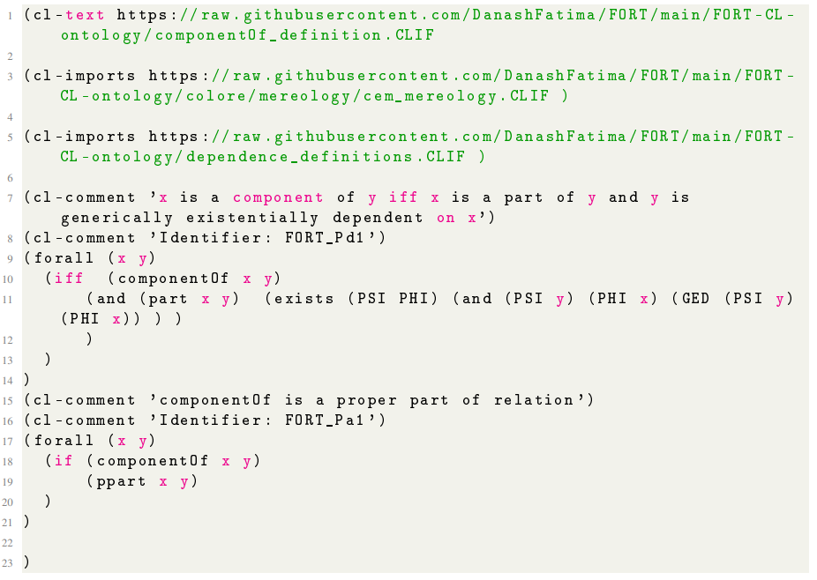
The FORT reference ontology (CL)
3
Contributions
Modelisation
Validating FORT using CL:
Running consistency checks using the CLIF serialization:
Import and reuse existing CLIF theories: mereology CEM, mereotopology MT, and location (Varzi)
Serialize other micro-theories in order of « what comes first »
Use the Hets tool to perform consistency checks on the FORT macrotheory
Translating FORT into other TPTP, LADR, and CASL syntaxes
Forming DOL ontologies and running automatic theorem proofs
The “component-of" relation in CLIF.
Contribution 2:
We have demonstrated the novelty and consistency of FORT by analyzing it in view of other meta-ontologies of relations and validating its consistency [F. Danash et al., 2022].
https://github.com/DanashFatima/FORT/tree/main/FORT-CL-ontology
F. Danash, D. Ziebelin, On the Analysis of FORT; arguments, alignment to FOs, and CLIF validation. In: The 6th Workshop on Foundational Ontology (FOUST VI),@ The Joint Ontology Workshops (JOWO’2022). Workshop paper.
Notes:
by serializing FORT in another formal language that validates the existence of models using consistency checks : a Common Logic (CLIF) serialization of the FORT reference ontology.
CL is a logical language based on FOL, with the purpose of standardizing syntax. It further extends FOL for that (1) any term can be used as function or predicate, and (2) sequence markers allow for talking about sequences of individuals directly, and in particular, provide a succinct way for axiomatising polyadic functions and predicates [Mossakowski2014]. CL is used in ontological theories as a formal language tool to prove the consistency of a theory by validating the existence of model(s) M for a theory T. For example, BFO 4 and some of DOLCE’s modules 5 are encoded in CLIF. In addition to FOs, "COLORE”, the open-access repository, is implemented as CL-ontology modules.
To write the CL ontology, we employ the CLIF serialization ("CLIF”, the Common Logic Interchange Format) which is specifically designed to represent ontologies and logical theories in a standardized and machine-readable manner.
Firstly we import those that are already encoded and available online at the "Colore” repository. These are : the CEM mereological theory 2 , the MT mereotopological theory along with the basic connection topological theory 3 , Varzi’s Location theory 4 , and their corresponding definitions. Note that, we modified some files e.g. the mereological definitions file to account for additional definitions e.g. overcross, undecross, etc, the location root file to remove region axioms, etc
Secondly, we initiate the serialization of FORT’s micro-theories in the sense of "what comes first", i.e. starting by the basic primitive relations that do not necessitate the use of other primitives, and moving on to relations that import other relations in their modules

Slide 41
The FORT lightweight ontology (SROIQ)
3
Contributions
Modelisation
Methodology step 3:
extract a secondary decidable fragment from the original formalization that guarantees desirable computational services, and translate the FOL-formalization into a decidable, yet expressive, knowledge representation and reasoning language : a SROIQ Description Logic formalization of the FORT lightweight ontology.
Theoretical formalization
Empirical validation
Reference Ontology
1
specify & formalize
2
analyze & validate
FOL
CL
Lightweight Ontology
extract & translate
3
SROIQ
Notes:
In the 3rd step:
extract a secondary decidable fragment from the original formalization that guarantees desirable computational services, and translate the FOL-formalization into a decidable, yet expressive, knowledge representation and reasoning language:
Yeilding in a SROIQ Description Logic formalization of the FORT lightweight ontology

Slide 42
The FORT lightweight ontology (SROIQ)
3
Contributions
Modelisation
The proposed translation procedure:
Input: a set of FOL formulas: S₀
Six steps:
Clausal Form (CF): S₁
Horn Rules (HR): S₂
Expressible Horn Rules (HR^{E}): S₃
Graph Rules (G_{R}): S₄
Non structured set of SROIQ axioms (SROIQ_{nonS}): S₅
Output: a structured set of SROIQ axioms: S₆
S₀
S₁
S₂
S₃
S₄
S₅
S₆
FOL
1
CF
2
HR
3
HR^{E}
4
G_{R}
5
SROIQ_{nonS}
6
SROIQ_{S}
NNF
PNF
SNF
CNF
Rewriting
Enclosed-rule
Connected-rule
Conceptualizing G
Simplifying G
Identifying G_{root}
Folding G
Composing axioms
Identifying structures
Simplicity
Regularity
Change form of rule?
Notes:
Figure 7.1 depicts the proposed procedure of steps which takes as input a set of axioms corresponding to a theory T formalized in FOL. Knowing that arbitrary FOL theories can contain predicates of any arity 1 , we narrow down the inclusion to only unary and binary predciates by assuming first and second arity FOL theories only.
After that, the procedure consists of six steps, in which each step comprises; an input set Si resembling the theory’s serialization in a specific logical formalism
The final output of the translation corresponds to a SROIQ serialization as a lite decidable fragment of the initial inputted FOL theory.

Slide 43
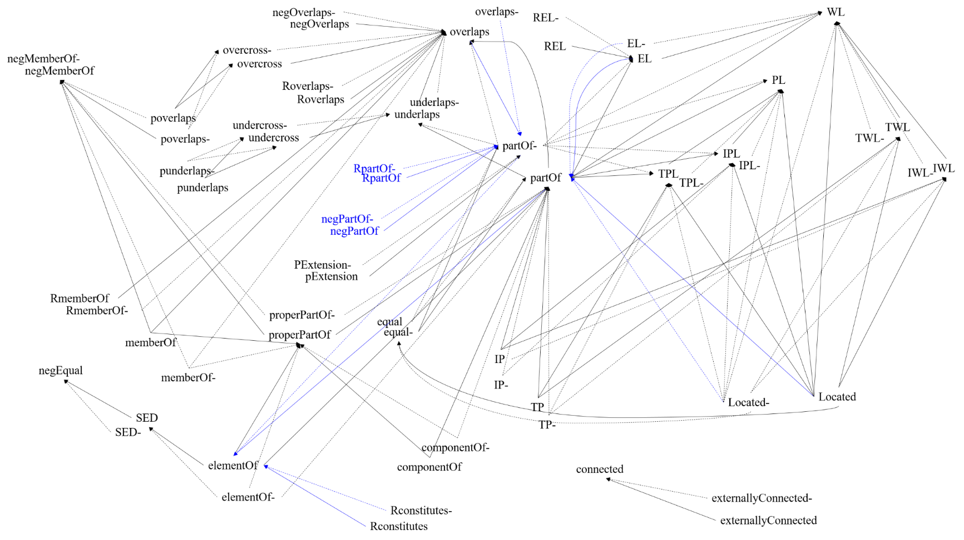
The FORT lightweight ontology (SROIQ)
3
Contributions
Modelisation
Translating the FORT FOL theory:
Steps 1 → 5
S₅: a set of 124 non-structured axioms
Step 6:
S₆: a set of 108 structured axioms
SED− ◦E ⊆ E (a1)
SED ⊆ ¬equal (a2)
SED◦ negE ⊆ ∅ (a3)
SED◦ SED ⊆ SED (a4)
componentOf ⊆ partOf (a5)
Tra(componentOf) (a6)
Irr(componentOf) (a7)
Asy(componentOf) (a8)
....
Contribution 3:
We have extracted a decidable fragment of FORT by translating the FOL theory into the decidable SROIQ, based on a generic and systematic procedure [F. Danash et al., 2023].
: Regular order
: Irregular order
https://github.com/DanashFatima/FORT/tree/main/FORT-SROIQ-formalization
F. Danash, D. Ziebelin, Translating FOL-theories into SROIQ-TBoxes. In: The ACM/SIGAPP Symposium On Applied Computing Modeling (SAC2023), Knowledge Representation and Reasoning track, 2023. Conference short paper.
Notes:
We use the proposed procedure to translate FORT from FOL to a SROIQ fragment.
The steps from 1 to 5 are straightfowrsard and yielded in 124 axioms. >>>1 such as the following
>>>2
As for step 6, it requires to identify the set of non-simple roles RNS and set of proposition builders,
>>>3
according to which we were able to draw The role hierarchy of FORT presenting the regular orders in black, and the irregular ones in blue between relations. As such we track the axioms yielding to irregular order and we the necessary minimal suppression of axioms yielding in a final SROIS set of 108 axioms.
The documentation of the procedure and the full SROIQ formalization is avaialble at the FORT github repository.
>>>4
So in this step, we have extracted a decidable fragment of FORT by translating the original FOL theory into the decidable SROIQ−D, based on a generic and systematic translation procedure

Slide 44
The FORT lightweight ontology (OWL)
3
Contributions
Modelisation
Methodology step 4:
specify and implement the T-boxes of the SROIQ formalization into a semantic web ontological model: an OWL2-DL implementation of the FORT lightweight ontology.
Theoretical formalization
Empirical validation
Reference Ontology
1
specify & formalize
2
analyze & validate
FOL
CL
Lightweight Ontology
extract & translate
specify & implement
3
4
SROIQ
OWL
Notes:
For the fourth step,
specify and implement the T-boxes of the SROIQ formalization into language relevant to the semantic web:
Resulting in an OWL2-DL implementation of the FORT lightweight ontology.
Why Semantic Web?
The particular focus on using semantic web technologies such as OW to serialize the ontology, is to emmerse the ontology in its lightweight version into the SW.
And why is that? It is because the SW offers the means in which individual can be stored as RDF graphs that are compliant to the ontology as their structure. And using the ontology’s semantics, we can naviagte the RDF graph of the data and query it using other SW technologies such as SPARQL to retrive new knowledge using reasoners.
Make link between ontology and the SW and difference between both
And emphasize the importance of Semantic Web

Slide 45
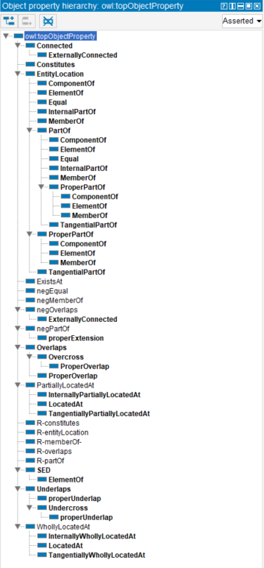
The FORT lightweight ontology (OWL)
3
Contributions
Modelisation
Implementing the OWL ontology using Protégé:
https://github.com/DanashFatima/FORT/tree/main/FORT-OWL-ontology
Notes:
As such, we use the Protege tool to encode the SROIQ axioms into the object property assertions resulting in the OWL ontology.

Slide 46
Direct and Indirect scenarios
3
Contributions
Employment
Methodology step 5:
import the ontology in practice according to the application setting, and link it to other ontologies based on an employment method : a proof of FORT’s applicability.
Global Ontology
Layer
FORT ontology
import & link
5
Core/ mid-level Ontology
Layer
Domain Ontology
Layer
A
B
Notes:
For the fifth and last step:
We design different methods for importing FORT in practice, at the global ontology layer, according to the application setting

Slide 47
Direct and Indirect scenarios
3
Contributions
Employment
Direct Employment
Direct Employment
Goal:
Use FORT’s relations as an expressive language to semantically enhance the domain relations of the domain/task ontology.
Task:
Alignment between the domain’s relations (R_{domain}) and FORT’s relations (R_{FORT})
<R_{domain}, (≡, ≤,≥) ,R_{FORT} >
FORT ontology
Global Ontology Layer
Core/Mid Ontology Layer
Ontology alignment - relations
Domain Ontology Layer
Notes:
First is the Direct Employment
To explain the figure:
At the global layer; we have FORT; an ontology of relations. We use only links to resemble FORT as a ontology of exclussive relations i.e. object properties.
At the domain layer, we have any ontology that consists of classes and properties
Goal: Use FORT’s relations as an expressive language to semantically enhance the domain relations of the domain/task ontology.
Task: Alignment between the domain’s relations (R_{domain}) and FORT’s relations (R_{FORT})
<R_{domain}, (≡, ≤,≥) ,R_{FORT} >

Slide 48
Direct and Indirect scenarios
3
Contributions
Employment
Indirect Employment
Goal:
Exploit the semantics of FORT within an interdisciplinary application in which multiple domain ontologies exist.
Integration-based:
Relations alignment
Concepts alignment
Aggregation-based:
Query translation
Graph saturation
Query translation
Indirect Employment
(a) Integration
(b) Aggregation
Global Ontology Layer
FORT ontology
FORT ontology
Ontology alignment - relations
FORT Graph saturation
FORT graph population-
via Query translation
Domain graph population-
via Query translation
Core/Mid Ontology Layer
Ontology alignment - concepts
Domain Ontology Layer
Notes:
Second is the Indirect Employment
To explain the figure:
At the global layer; we have FORT; an ontology of relations. We use only links to resemble FORT as a ontology of exclussive relations i.e. object properties.
At the domain layer, we have any ontology that consists of classes and properties
Goal: Exploit the semantics of FORT within an interdisciplinary application in which multiple domain ontologies exist.
And here we have two scenarios
First th case
Integration-based:
Relations alignment
Concepts alignment
Second, the case …
Aggregation-based:
Query translation
Graph saturation
Query translation

Slide 49
Direct and Indirect scenarios
3
Contributions
Employment
Methodology step 4:
specify and implement the T-boxes of the SROIQ formalization into a semantic web ontological model: an OWL2-DL implementation of the FORT lightweight ontology.
Methodology step 5:
import the ontology in practice according to the application setting, and link it to other ontologies based on an employment method : a proof of FORT’s applicability.
Contribution 4:
We have provided an OWL ontology and designed its possible employment methods to supported the practice of FORT in the Semantic Web.
Notes:
And so with bothe steps 4 and 5
We have provided an OWL ontology and designed its possible employment methods to supported the practice of FORT in the Semantic Web .

Slide 50
Table of contents
1
4
2
3
Introduction
Conclusion &
Perspectives
State of the art
Contributions
I: Ontologies for Cultural Heritage
II: Foundational Ontological Relations
Notes:
For that, I introduce first the Patrimalp project in the introduction section,
then a two-parts SOA,
followed by the contributions section,
after which I conclude.

Slide 51
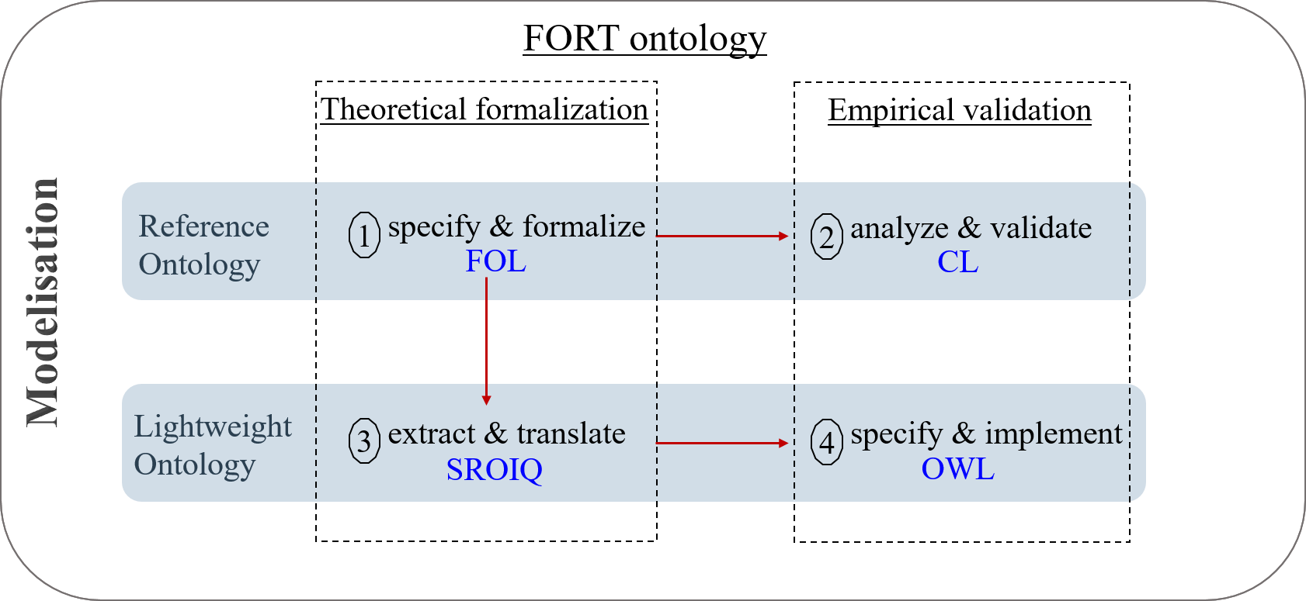
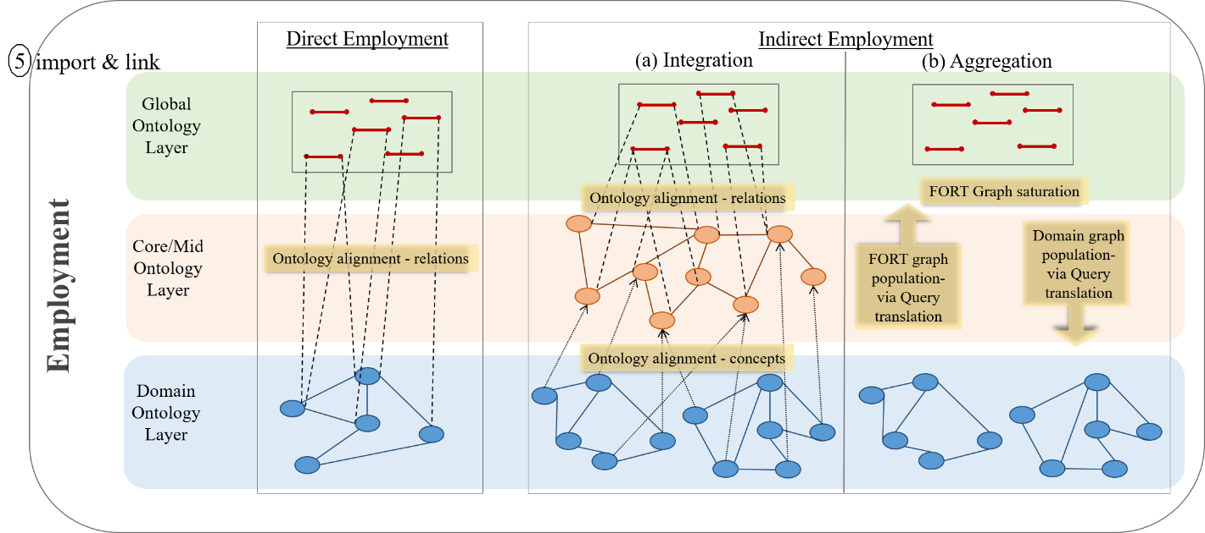
4
Conclusion & Perspectives
List of Contributions
Applied Ontological Approach & Ontology engineering Methodology:
Notes:
In this thesis, we have presented an applied ontological approach within an ontology engineering methodology to address the objective of
« Representing and modeling the composition of a tangible entity in general, and a Cultural Heritage tangible entity in particular, using foundational ontological structural and spatial relations »
The methdology takes into account
+ different specification choices: Expressivity & Decidability
+ multiple formalization levels: Theoretical & Empirical
+ Bridging the two specifications
As such, our contributions are as follows:

Slide 52
4
Conclusion & Perspectives
List of Contributions
Applied Ontological Approach & Ontology engineering Methodology:
Proposed an unified and well-founded language of relations and rule constraints: FORT_{FOL} reference ontology [methodology-step-1]
Demonstrated the novelty and consistency of our proposed language in view of existing theories: FORT_{CL} reference ontology [methodology-step-2]
Established a decidable formalization of our proposed language with a generic translation procedure: FORT_{SROIQ} lightweight ontology [methodology-step-3]
Supported the practice of our proposed language in the SW and designed its employment methods: FORT_{OWL} lightweight ontology + practice design [methodology-steps-4+5]
Notes:
As such, our contributions are as follows:
Proposed an unified and well-founded language of relations and rule constraints: FORT_{FOL} reference ontology [methodology-step-1]
Demonstrated the novelty and consistency of our proposed language in view of existing theories: FORT_{CL} reference ontology [methodology-step-2]
Established a decidable formalization of our proposed language with a generic translation procedure: FORT_{SROIQ} lightweight ontology [methodology-step-3]
Supported the practice of our proposed language in the SW and designed its employment methods: FORT_{OWL} lightweight ontology + practice design [methodology-steps-4+5]

Slide 53
4
Conclusion & Perspectives
List of Contributions
Going back to Patrimalp’s research problem:
FORT has laid the foundation for representing the materiality of a cross-disciplinary tangible entity, providing thus the primary element of this representation and making it available for future architectural development in CH applications.
META (Foundational - Top-level – Upper) Ontologies
Mid-level Ontologies
Core ontologies
Domain/Task Ontologies
Application Ontologies
FORT ontology
→ A contribution at a meta-level
The foundation for representing the materiality of tangible entity
Archaeology, History of arts
← A cross-disciplinary heritage object

Slide 54
The CH application:
4
Conclusion & Perspectives
Future Directions
Research
Close-term
An ontology architecture for a CH interdisciplinary application using FORT
INDIRECT Employment: using the strength of each of FORT, CIDOC CRM, EDM, and CHARM
The FORT ontology
Composition relations
Ontology alignment - relations
The CIDOC CRM & EDM Core/Mid Ontology
Spatiotemporal elements
Descriptive elements
categories
Ontology alignment - concepts
Possible domain ontologies e.g. CHARM
User models
Notes:
Regarding the employment of FORt within an ontology architecture for CH, and following the synthesis of the SOA on ontology models for CH
We could proceed with the following indeirect employment for an interdisciplinary integration.
I.E. using three a ontology layers architecture
FORT at the global ontology layer as the ontology of relations
CIDOC CRM at the core ontology layer for ontological catgeories about CH entities + spatiotemporal aspects
EDM also the core/mid-level ontology layer for descriptive aspects about entities
And some possible domain ontologies for each discipline e.g. CHARM for archeaological sites, another part of CHARM for geology, another ontology of colors and materials, etc.

Slide 55
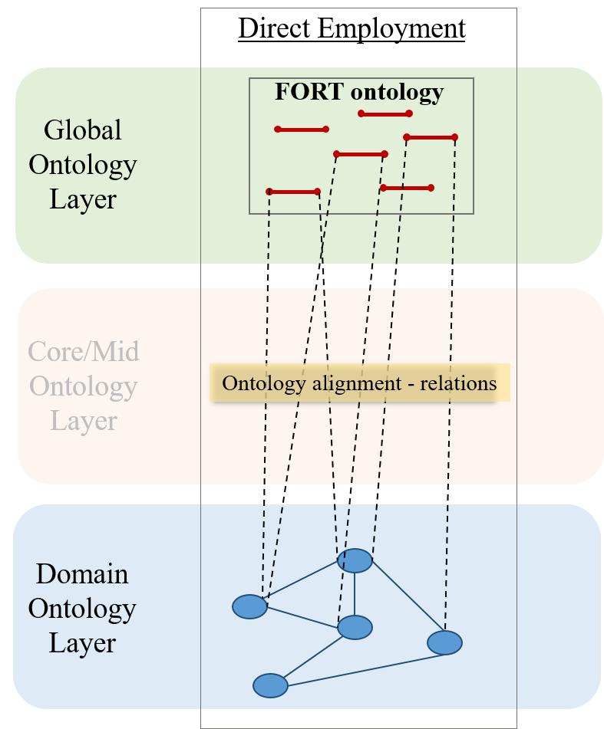
The CH application:
4
Conclusion & Perspectives
Future Directions
Development
Close-term
Demonstrate FORT’s convenience for materiality representation of entities in Patrimalp
DIRECT Employment examples
Two examples:
Archaeology Ontology
Brocades Ontology
Notes:
Regarding the employment of FORt within an ontology architecture for CH, and following the synthesis of the SOA on ontology models for CH
We could proceed with the following indeirect employment for an interdisciplinary integration.
I.E. using three a ontology layers architecture
FORT at the global ontology layer as the ontology of relations
CIDOC CRM at the core ontology layer for ontological catgeories about CH entities + spatiotemporal aspects
EDM also the core/mid-level ontology layer for descriptive aspects about entities
And some possible domain ontologies for each discipline e.g. CHARM for archeaological sites, another part of CHARM for geology, another ontology of colors and materials, etc.

Slide 56
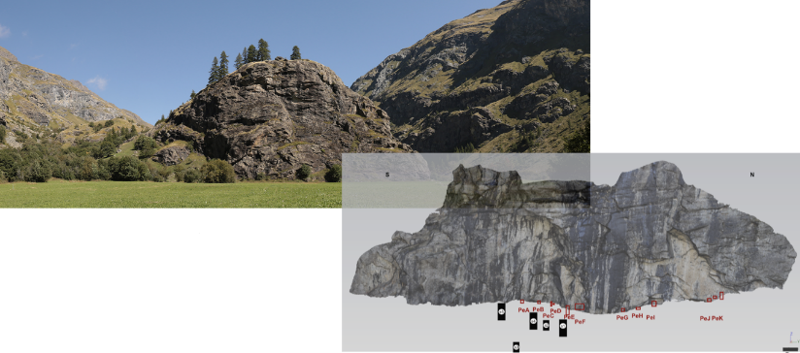
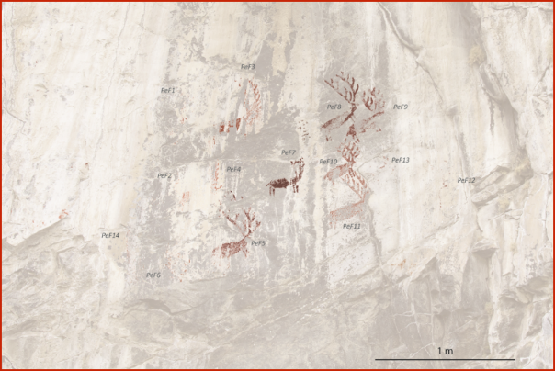
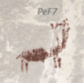
The CH application:
4
Conclusion & Perspectives
Future Directions
Development
Close-term
Demonstrate FORT’s convenience for materiality representation of entities in Patrimalp
DIRECT Employment: (1) Archaeology example
Query 1: Find the red deers on panels of the north face of RDC.
Select distinct ?figure Where {
?rdc rdf:type archeo:ArchaeologicalSite;
rdfs:label "Rocher du Château"@fr .
?rdc fort:hasTPP ?nf.
?nf rdfs:label "Face Nord"@fr;
fort:hasPP ?panel .
?panel fort:hasEL ?figure .
?fig ure fort:memberOf ?c;
fort:hasPP ?ms.
?c fort:unifiedBy ?p.
?p archeo:hasShape archeo:dearShape.
?ms fort:constitutedBy ?cm.
?cm fort:hasElement chemicals:Hematite.
}
Notes:
Show the convenience of FORT in achieving the objective of representing the materiality.
At the beginning of the presentation, when I talked about the shared goal, I mentioned one its consequence that this study of materiality will allow the
“Understand the materiality of the tangible entity & link entities that have similar composition“
To do so, let’s consider some queries : using real data from the Patrimalp project and not only theoretical examples.
------------------------------------------------------------------------------------------------------------------
Let’s consider there is database concerning the archeology domain, very simple one which describes an archeaological site
Using FORT’s relations, we want to
Query 1: Find the red dears on panels of the north face of RDC.
Select distinct ?figure
Where
{
?RDC rdf:type domain:ArchaeologicalSite
?RDC fort:hasTPP ?NF
?NF fort:hasPP ?panel
?panel fort:hasEL ?fig
?fig fort:memberOf ?c1
?c1 fort:unifiedBy {domain:hasShape “dear”}
?fig fort:memberOf ?c2
?c2 fort:unifiedBy {domain:hasColor “red”}
}
------------------------------------------------------------------------------------------------------------------
Now let’s consider there is database concerning the brocades, very simple one which describes there analysis
Using FORT’s relations, we want to
Query 2: Find the brocades which are located on the “Saint Jean” personage of the “Vierge de Pitié” statue and have “CL” in the tin layer.
Select distinct ?brocade
Where {
?brocade fort:EL ?S
?s domain:Name “Saint Jean”
?s fort:PartOf ?SS
?ss domain:Name “Vierge de Pitié”
?microsample fort:PartOf ?brocade
?microsample fort:hasMember ?layer
?layer fort:constitutedBy ?m
?m domain:name « tin layer »
?m fort:hasElement « CL »}

Slide 57
The CH application:
4
Conclusion & Perspectives
Future Directions
Development
Close-term
Demonstrate FORT’s convenience for materiality representation of entities in Patrimalp
DIRECT Employment: (2) Brocades example
Query 2: Find the brocades which are located on the “Saint Jean” personage of the “Vierge de Pitié” statue and have “Cl” in the tin layer.
Select distinct ?b Where {
?s1 a brocades:Statue;
rdfs:label "Vierge de Pitié".
?s2 fort:partOf ?s1 ;
rdfs:label "Saint Jean"@fr.
?b a brocades:Brocade ;
fort:EL ?s2 .
?ms a brocades:MicroSample;
fort:partOf ?b ;
fort:hasMember ?l .
?l fort:constitutedBy ?m .
?m brocades:layerType brocades:TinLayer ;
fort:hasElement chemicals:Chlorine .}
Notes:
Show the convenience of FORT in achieving the objective of representing the materiality.
At the beginning of the presentation, when I talked about the shared goal, I mentioned one its consequence that this study of materiality will allow the
“Understand the materiality of the tangible entity & link entities that have similar composition“
To do so, let’s consider some queries : using real data from the Patrimalp project and not only theoretical examples.
------------------------------------------------------------------------------------------------------------------
Let’s consider there is database concerning the archeology domain, very simple one which describes an archeaological site
Using FORT’s relations, we want to
Query 1: Find the red dears on panels of the north face of RDC.
Select distinct ?figure
Where
{
?RDC rdf:type domain:ArchaeologicalSite
?RDC fort:hasTPP ?NF
?NF fort:hasPP ?panel
?panel fort:hasEL ?fig
?fig fort:memberOf ?c1
?c1 fort:unifiedBy {domain:hasShape “dear”}
?fig fort:memberOf ?c2
?c2 fort:unifiedBy {domain:hasColor “red”}
}
------------------------------------------------------------------------------------------------------------------
Now let’s consider there is database concerning the brocades, very simple one which describes there analysis
Using FORT’s relations, we want to
Query 2: Find the brocades which are located on the “Saint Jean” personage of the “Vierge de Pitié” statue and have “CL” in the tin layer.
Select distinct ?brocade
Where {
?brocade fort:EL ?S
?s domain:Name “Saint Jean”
?s fort:PartOf ?SS
?ss domain:Name “Vierge de Pitié”
?microsample fort:PartOf ?brocade
?microsample fort:hasMember ?layer
?layer fort:constitutedBy ?m
?m domain:name « tin layer »
?m fort:hasElement « CL »}

Slide 58
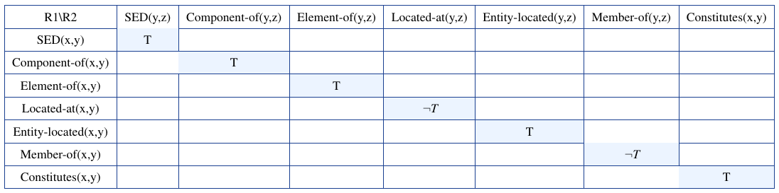
The FORT reference ontology:
4
Conclusion & Perspectives
Future Directions
Research
Long-term
From an atemporal to a temporal framework
Incorporating time e.g. using a time variable and ternary relations, interval-based temporal logic, temporal constraints using that extend some logics (DLR with “since” and “until”)
Study the events that affect the structural and spatial representation of a tangible entity e.g. LODE ontology
Model the behavior between a relation R and an event E
Composition of foundational ontological relations
Notes:
Is Regarding the FORT reference ontology, to go with Further extensions of FORT’s relations in the Applied ontology field
>>>>> ADD link of time to CH entities
One notable simplification made in Chapter 5 is the treatment of time, which is not explicitly addressed in FORT. This decision has been made for that the ontological choices regarding time should be approached after establishing framework for the theory’s fundamental elements : foundational ontological relations. Additionally, temporal considerations are complex and need to be taken in a separate step. Thus, a perspective to our work is to extend FORT to a temporal framework.
This will allow to :
+ study the behavior of each of FORT’s relations upon events that alter tangible structures. Thus, drawing insights on the evolution of relations upon changes with time.
+ extend its capabilities from representing the composition of a tangible entity to representing the spatiotemporal evolution of this composition with time. And thus, to draw insights on the lifeline of tangible structures.
How?
a- incorporating time …. These will allow for the representation of entities, and the relation holding between them at different time points (e.g. t1, t2, etc.), providing a snapshot of their state at each scenario.
b- This enables the representation of the continuous lifeline of an entity, demonstrating the changes that have influenced its structural and spatial aspects.
C- attention should be given to the behavior of entities linked by relation R at time t1 in response to a change event E. Some valuable insights can be derived from the work of Artale et al. [Artale2008]. This analysis allows for reasoning about the evolution of relations over time and predicting the nature of relation R2 at time t2 following the occurrence of change event E
--------------------------------------------------------------------------------------------------------------
Within the FORT framework, we have successfully addressed the transitivity of each individual relation, enabling reasoning on the composition of uni-typed relations, specifically R1 ◦R1 → R1. A possible perspective regarding this topic, is to explicitly tackle the issue of multi-typed relation composition. For example, given R1(x, y)∧R2(y,z), it could be the case where the relation holding between x and z could be further determined, if any.
+ it allows us to deduce new data that may not be explicitly stated within the knowledge base of relationships.
+ it facilitates the discovery of patterns or regularities among relationships, enabling us to observe their application to real-world data and utilize these insights for further enhancement
→ To study the composition of relations, a commonly employed method would be constructing a composition table for the different relations, analogous to the approach taken with RCC8 relations 1 as shown in Table 9.1.

Slide 59
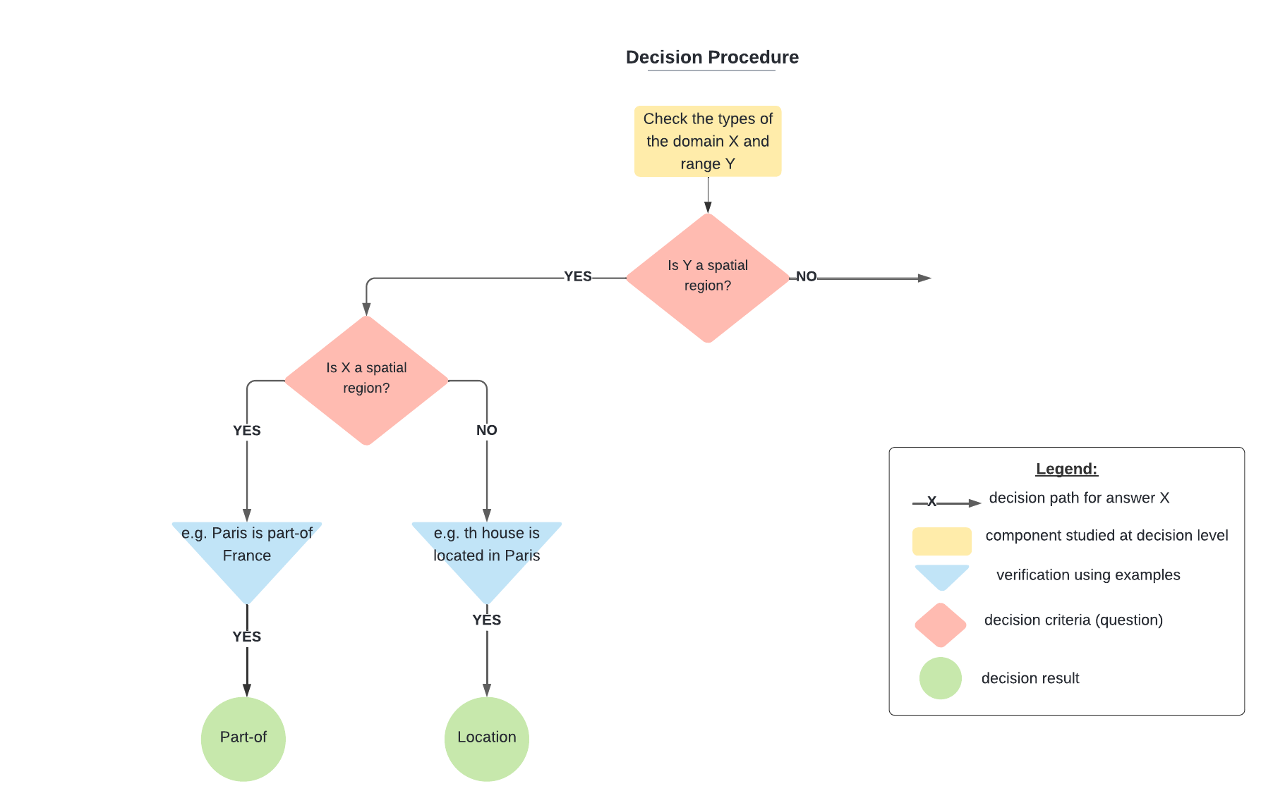
The FORT lightweight ontology:
4
Conclusion & Perspectives
Future Directions
Development
Close-term
A semi-automatic decision procedure for the Direct employment of FORT
Notes:
Design and develop a tool to support the direct employment method of FORT within domain ontologies.

Slide 60
Publications:
F. Danash, D. Ziebelin, Translating FOL-theories into SROIQ-TBoxes. In: The ACM/SIGAPP Symposium On Applied Computing Modeling (SAC2023), Knowledge Representation and Reasoning track, 2023. Conference short paper.
F. Danash, D. Ziebelin, On the Analysis of FORT; arguments, alignment to FOs, and CLIF validation. In: The 6th Workshop on Foundational Ontology (FOUST VI),@ The Joint Ontology Workshops (JOWO’2022). Workshop paper.
F. Danash, D. Ziebelin, FORT: a minimal Foundational Ontological Relations Theory for Conceptual Modeling Tasks. In: The 41st International Conference on Conceptual Modeling (ER2022), Forum track, 2022. Conference paper.
F. Danash, D. Ziebelin, E. Chalmin, A Parthood Approach for Modeling Tangible Objects’ Composition TOC – An application on Cultural Heritage. In Book: The 17th Extended Semantic Web Conference, ESWC2020. Lecture Notes in Computer Science, vol 12124. Conference short paper.

Slide 61
Thank You!
Fatima DANASH
Doctoral Thesis defended on September 28th, 2023
My most profound gratitude is to God.

